Slide 1
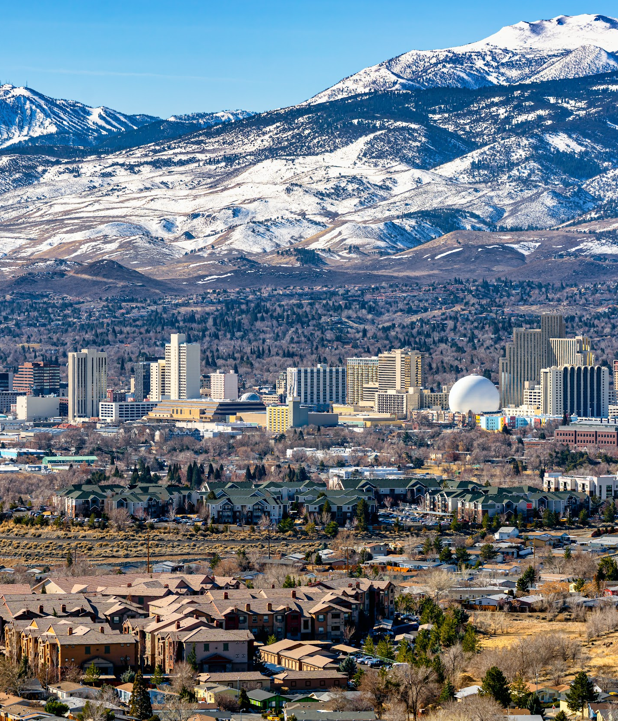


Comprehensive Climate Analysis
for Nevada (CCAN)
Final Presentation
December 9, 2025
1.

Slide 2
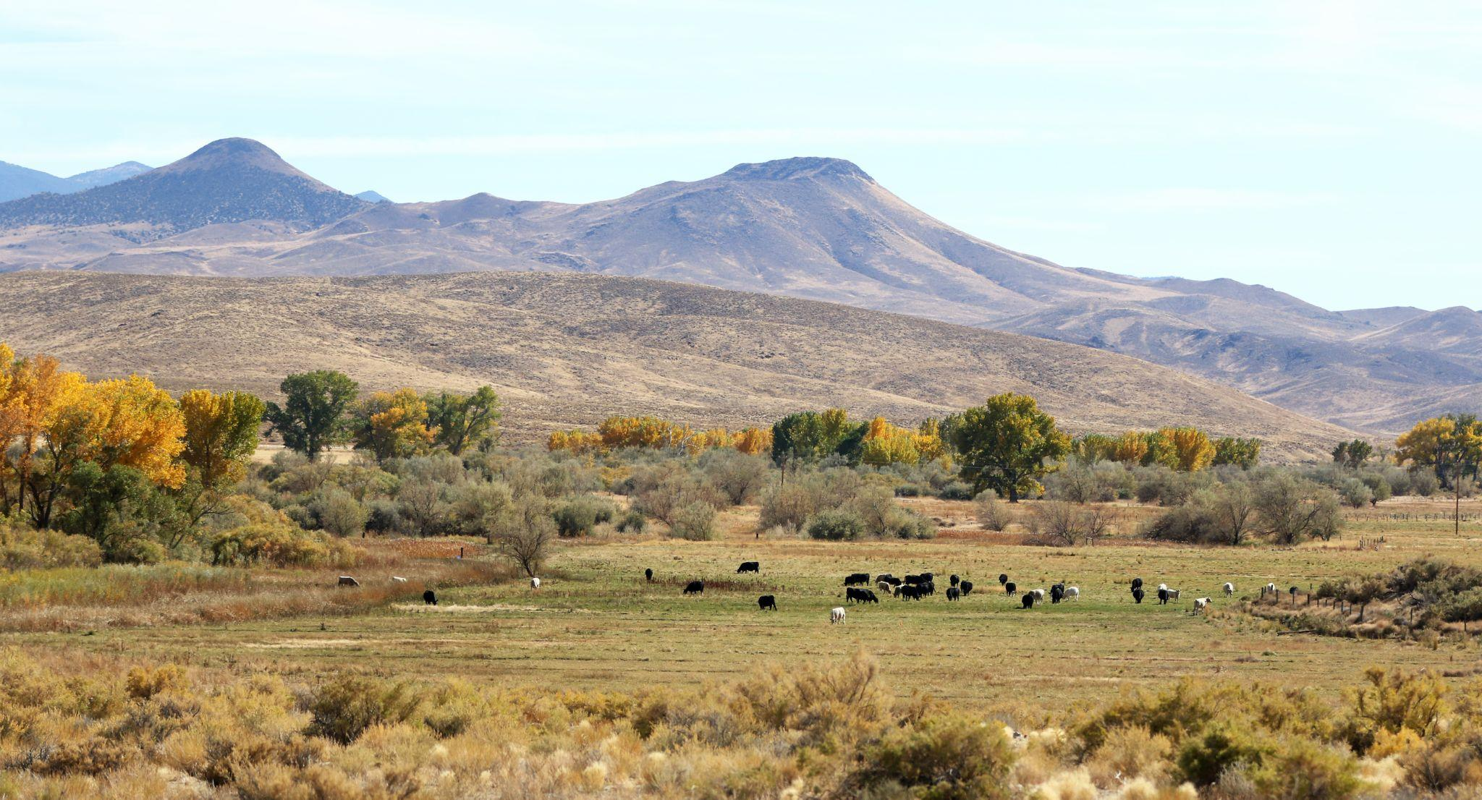

Welcome

Slide 3

Online Housekeeping
Use the Chat to make comments and ask questions.
Use the Zoom Q+A to ask NDEP and the consultants questions.
Keep microphones off, cameras are optional.

Slide 4
Objectives
Share a final overview of the Comprehensive Climate Analysis
for Nevada (CCAN).
Share the comments we received during the public comment period.
Answer any remaining questions and/or comments about the CCAN.

Slide 5

Agenda
CCAN Introduction & Overview 10 minutes
Public Comment Feedback 10 minutes
Emission Reduction Scenarios 5 minutes
Opportunity Areas 5 minutes
Community Benefits 5 minutes
Closing 5 minutes

Slide 6
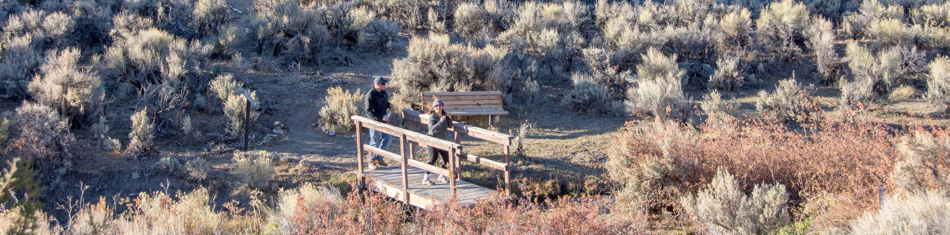
CCAN Introduction
& Overview
Photo taken and owned by NDCNR, permission granted to NDEP

Slide 7
Climate Pollution Reduction Grants (CPRG)
Goals
To reduce GHG emissions
To reduce air pollution
To create benefits for disadvantaged communities
To leverage other resources to maximize GHG reductions
A grant administered by the EPA, out of the Inflation Reduction Act.
Overall $5 billion in grants to states, local governments, tribes, and territories.
‹#›
6

Slide 8
Two Projects in One
Priority Plan
High-priority, near-term, implementation-ready actions
State-wide GHG inventory
Actions gathered from community members and SSG’s Actions Database, in key sectors
Selection for:
High emissions impact
Low-income and at-risk benefits,
‘Implementation-ready’
Comprehensive Plan
Plan to help reach important long-term reduction goals.
Comprehensive modeling and analysis of geographically-specific actions to achieve long-term, emissions reduction goals.
In-depth analysis on sectors, finanacials and co-benefits of actions
Submitted March 2024
Submitted Dec 1, 2025
6

Slide 9
CCAN Approach: Iterative Feedback + Analysis
Data Collection
Engagement
Input
Inputs
Target Setting
Low Carbon Action Selection & Refinement
How can this be implemented?
Process
Calibration
Business as Usual Modeling
Low Carbon Modeling
Financial Analysis
Co-Benefit & Co-Harm Analysis
Base Year GHG Inventory
Future Emissions Projection
Low-Carbon Scenarios
Plan
Outputs
3 Scenarios were made for the CCAN

Slide 10
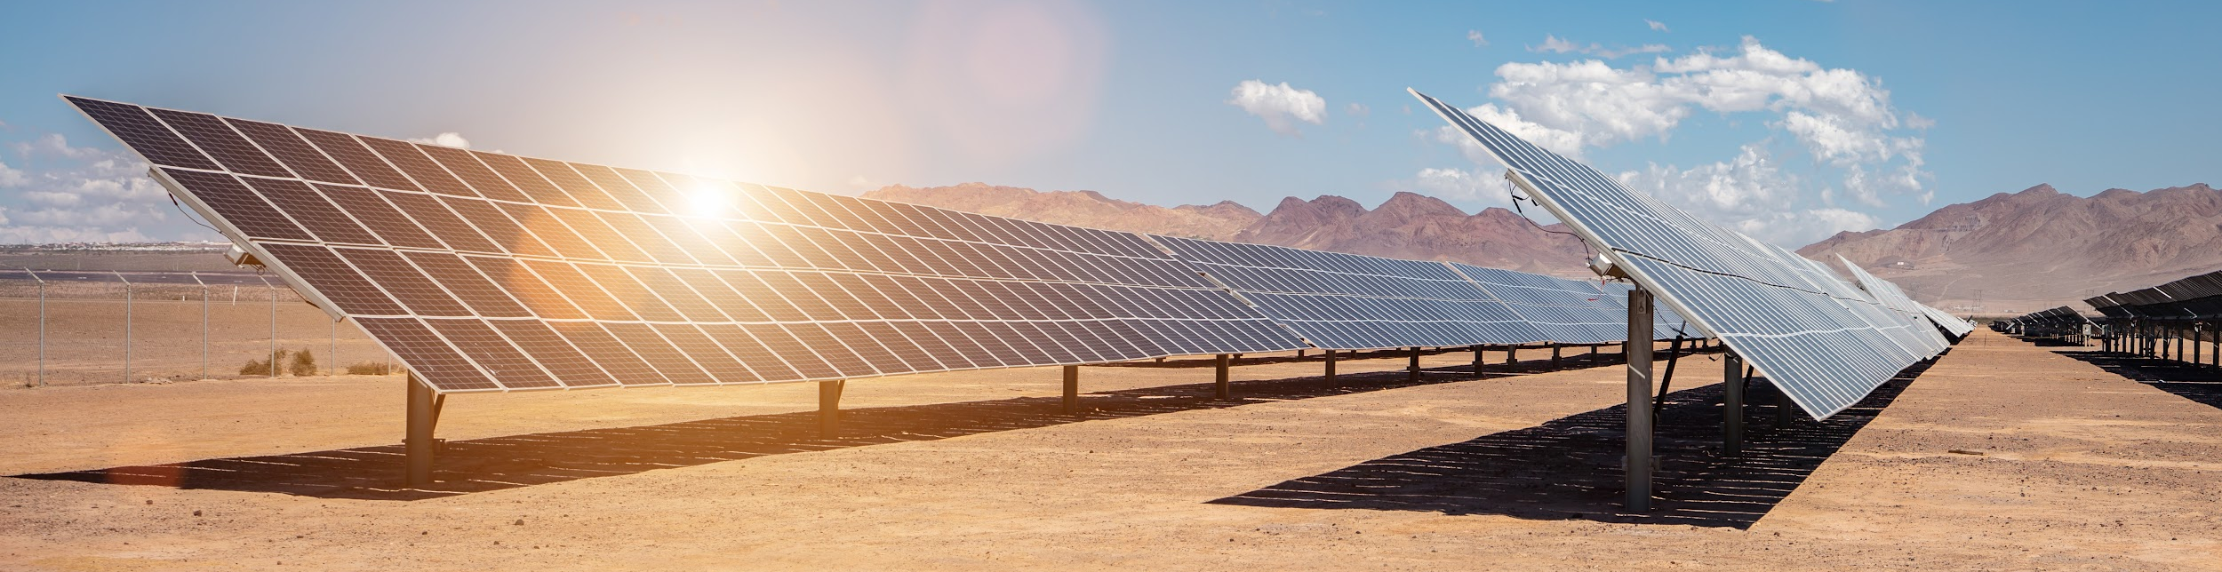

CCAN Purpose
Provide Nevadans with a key resource for making informed decisions about climate measures that directly reduce emissions while improving health, resiliency, and quality of life in their communities.

Slide 11
Process
Create GHG Inventory and
BAU & BAP Scenarios
Target Analysis and Engagement
Future Scenario Modeling and Direct Outreach
Public Input to
Finalize Plan
Final Plan submitted to the EPA
Collect Data
Draft Plan
Spring 2024
Summer 2024
Fall 2024 /
Winter 2025
Spring 2025
Summer 2025
Fall 2025
Winter 2025

Slide 12

How to Read the CCAN
This analysis is intended for everyone — residents, governments, businesses, utilities and other partners.
It outlines how climate measures could reduce emissions and generate co-benefits such as improved air quality and public health outcomes alongside increased economic development.
The CCAN is a resource to help inform implementation of measures at a variety of scales and is not intended to be a roadmap of how greenhouse gas emissions should be reduced in Nevada.
6

Slide 13
Outline of CCAN
Executive Summary: A quick overview of the key points of analysis - read this first!
Engagement Findings: How residents, organizations, and partners helped shape the analysis.
GHG Inventory: A summary of where emissions come from.
Reference Scenarios: What emissions could be under “business-as-usual” (BAU) and “business-as-planned” (BAP) scenarios.
Targets: Emission reduction goals for Nevada in 2030 and 2050.
Reduction Measures and Emissions Projections: An overview of the proposed three scenarios:
Low Carbon Scenario
Mixed Fuel Scenario
Community Driven Scenario
6

Slide 14
Outline of CCAN (Continued)
Implementation Strategies: How measures could move from vision to reality with specific entities, funding sources, and timelines defined.
Benefits: An overview of impacts like cleaner air, cost savings, and job creation, including expected benefits for low income and at-risk communities.
Workforce Planning: A look at the jobs and training needed to carry out the proposed measures.
Glossary & Appendix: More details and explained methodology explained.
6

Slide 15
Public Comment Feedback
Photo taken and owned by NDCNR, permission granted to NDEP

Slide 16
What Happened
Two online workshops
One hybrid workshop in Reno
One presentation with the Nevada Climate Forum
Open comment period Sept 8 - Oct 10, 2025
Engagement Activities for
the Draft CCAN
September - October 2025
6

Slide 17
How Was
Feedback Incorporated?
Comments were collected via an online submission form, email, and during meetings and consultations.
All input was reviewed and synthesized by the project team.
Comments were incorporated into the report, with revisions made in the relevant sections to reflect community priorities and strengthen the plan.
Engagement Activities for
the Draft CCAN
6

Slide 18
Key
Feedback
Air Pollution and Public Health
Concern about respiratory and cardiovascular impacts, with emphasis on risks for children, seniors, and low-income residents.
Transportation and Mobility
Support for expanding transit, walking, and biking options, and for shifting public and heavy-duty fleets to zero-emission vehicles.
Clean Energy and Priority Communities
Support for expanding transit, walking, and biking options, and for shifting public and heavy-duty fleets to zero-emission vehicles.
6

Slide 19
Key
Feedback
Community Empowerment
Support for using equity metrics and conducting targeted outreach, including rural and bilingual education on solar and financing programs.
Tree Canopy Coverage and Heat Resilience
Interest in expanding tree canopy in heat-exposed areas and choosing species adapted to desert conditions.
Waste, Healthcare, and Ancillary Sectors
Encouragement to increase recycling, diversion, and reuse in healthcare and other high-waste sectors.
6

Slide 20
Key
Feedback
Impact of Data Centers
Concern about rising energy demand and emissions from Nevada’s expanding data-center sector.
Innovation and Technology Pathways
Interest in solar innovation (rooftop, agrovoltaics, ecovoltaics), battery storage, and emerging geothermal and hydrogen options.
Implementation, Communication, and Governance
Requests for clear responsibilities, next steps, and ongoing, transparent communication after the plan is completed.
6

Slide 21
Key
Feedback
Overall, participants expressed strong support for the CCAN process, recognizing its technical depth and practical focus while emphasizing that policies should advance health, accessibility, and affordability.
They underscored the importance of achieving measurable health benefits and long-term cost savings, particularly for communities most in need.
6

Slide 22
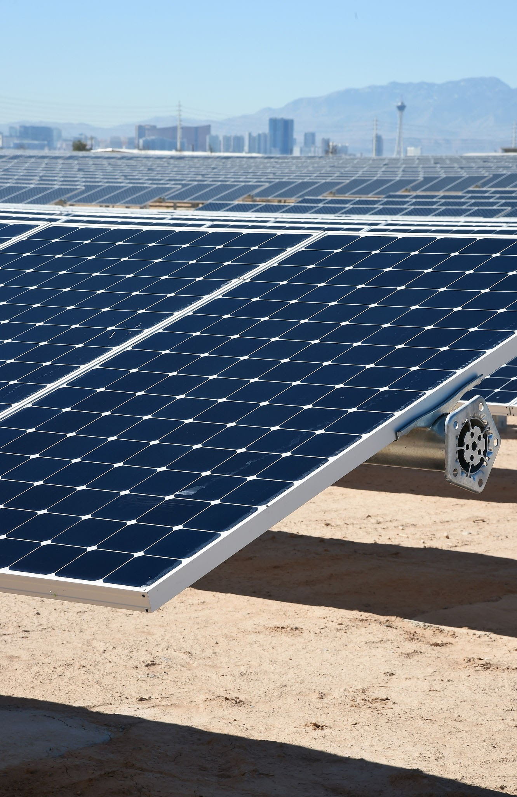
Q+A
Questions or clarifications?
Add your questions to the chat or raise your hand.

Slide 23
Emissions Reduction Scenarios
Photo taken and owned by NDCNR, permission granted to NDEP

Slide 24
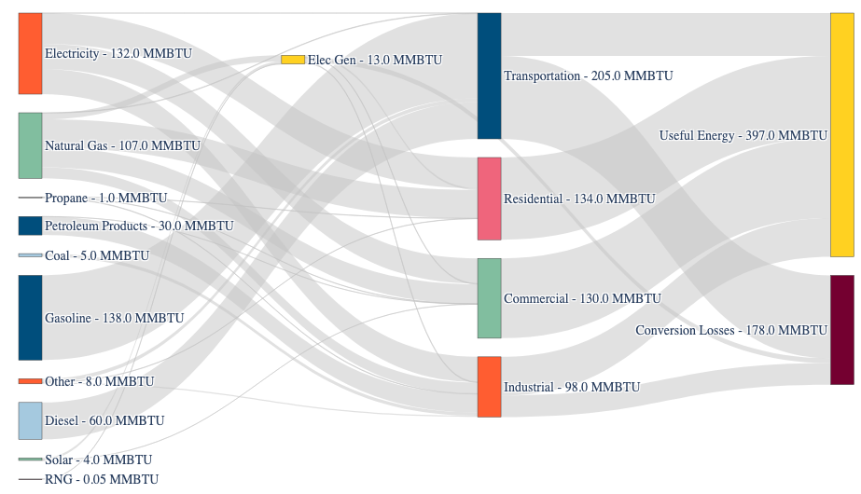
Energy Sources
Sectors
Outputs
Starting Point:
Nevada’s
Energy System (2021)
31% of Nevada’s energy is lost

Slide 25



The Modeled Scenarios
What would happen if…?
Low Carbon (LC)
Mixed Fuels (MF)
Community-Driven (CD)
Accelerated clean grid
Ambitious retrofits and building performance
Net zero building code
Transition to ZEVs
Decarbonize industry
Actions are more aligned with State’s current goals
Fossil fuels stay longer
Transition is less aggressive
More hydrogen and RNG are in the mix
Actions are focused on low-income and at-risk areas first
Accelerate distributing benefits to more people
Robust active and public transportation

Slide 26
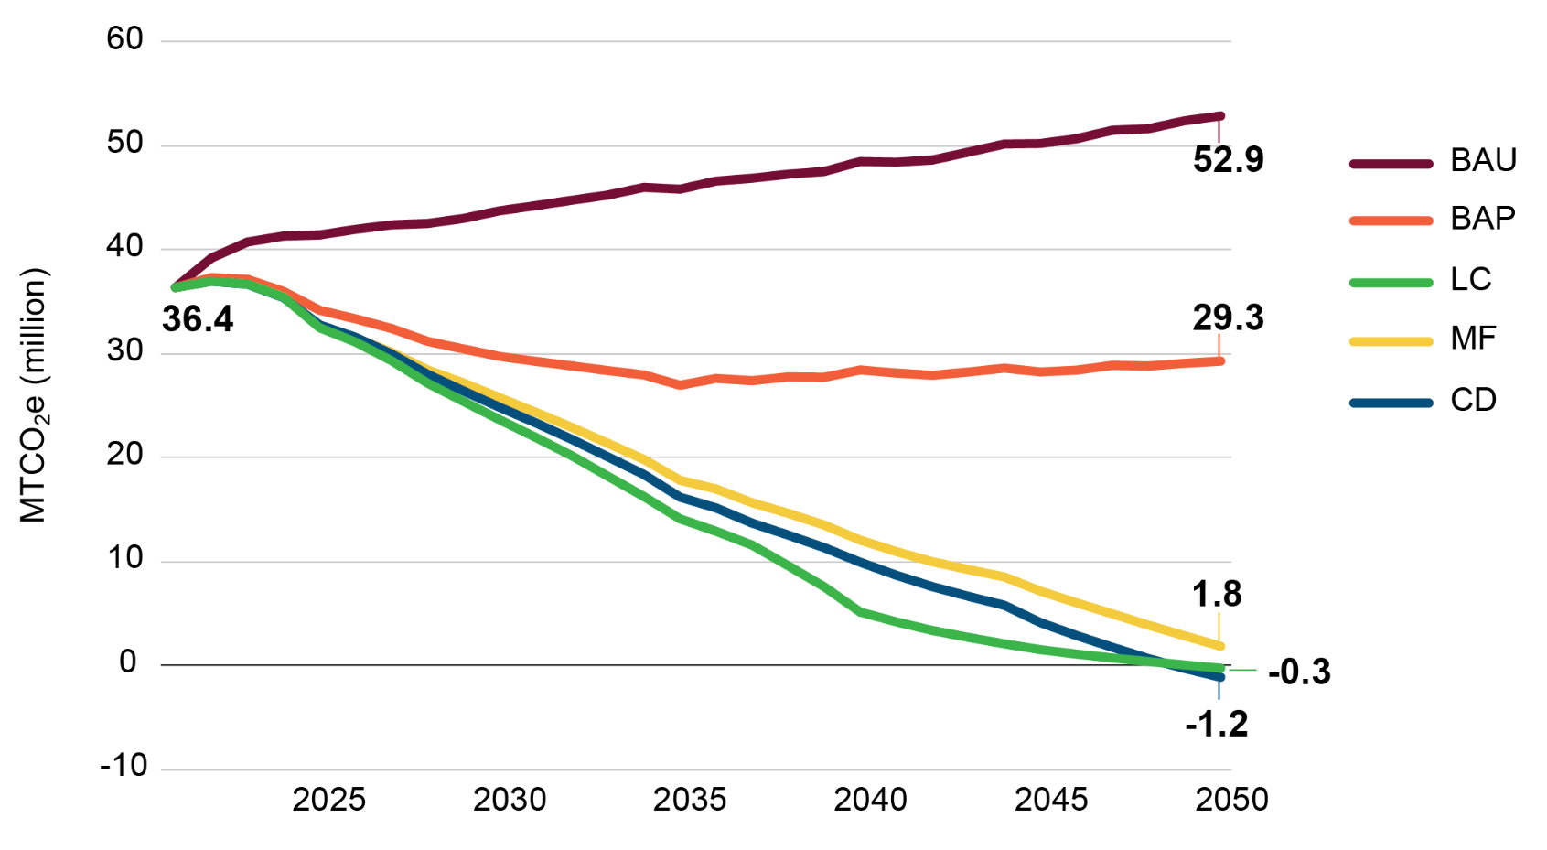
Scenario Comparison
Total Net Emissions for Each Scenario
There are multiple pathways to zero emissions by 2050, or even earlier.
6
Notes:
Here are the scenarios we modelled… you can see the starting point is 35 MMtCO2e, and if things continue according to current technologies and activities, this increases to 52 MMtCO2e by 2050… but the good news is that there are multiple pathways to get to nearly 0 by 2050 or even before 2050 and those are the scenarios that we have developed and evaluated. Lets take a slice of these scenarios in 2050 to see what it looks like.
BAU - 52 MtCo2e
BAP - 28.3 MtCo2e
LC: -0.66 MtCo2e
MF: 1.1MtCo2e
CD: -1.7 MtCo2e

Slide 27
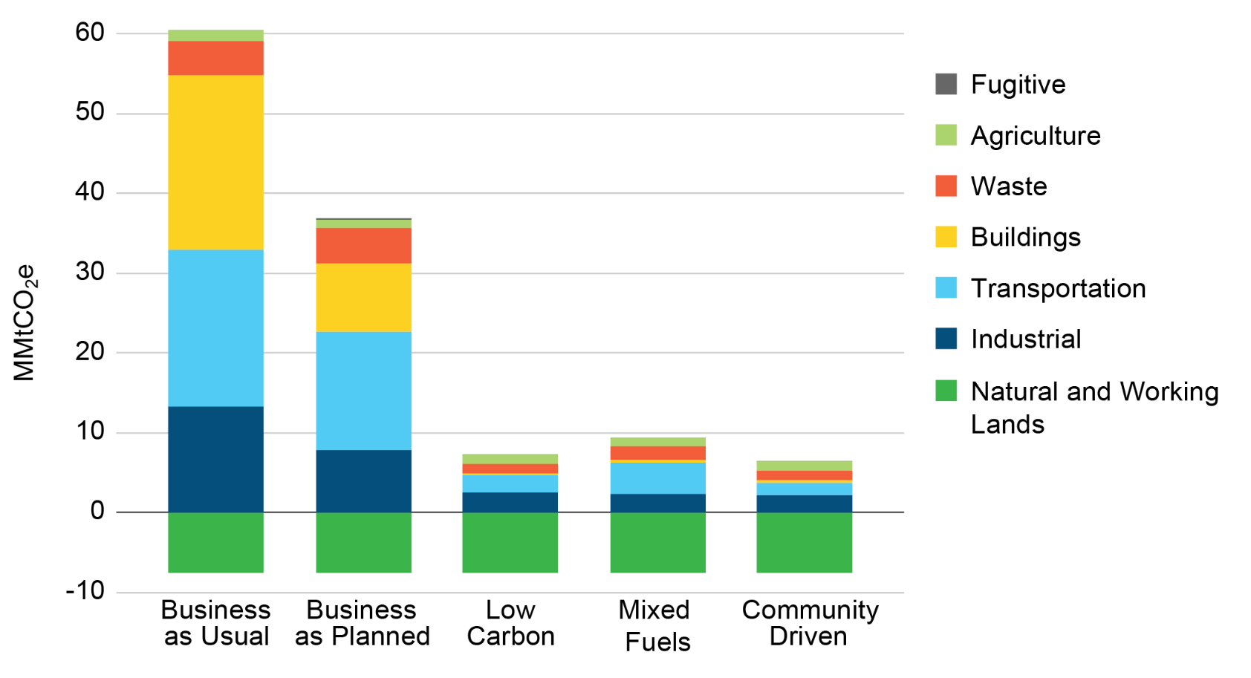
Scenario Comparison
Total Emissions for Each Scenario by Sector, 2050
6
Notes:
Here are the 2050 GHG emissions profiles by sector for each of the five scenarios. What are your observations?
Three scenarios get very close to zero with some emissions remaining in transportation, industry, waste and agriculture. These low carbon scenarios are very different pictures of the world than the BAU and the BAP, even though the BAP is nearly half of the emissions of the BAU.

Slide 28
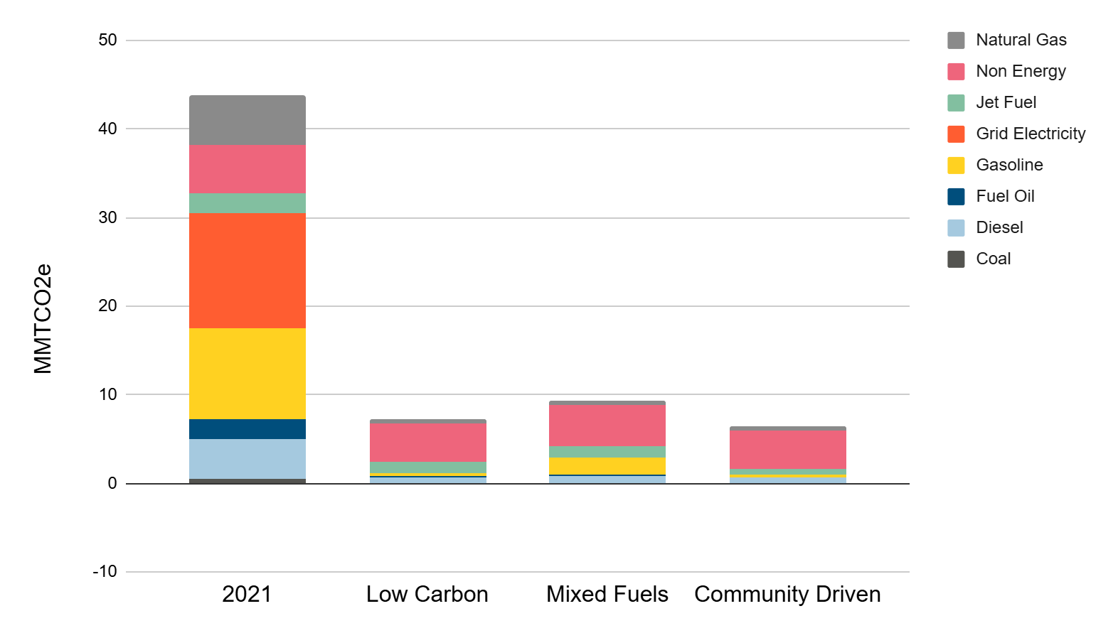
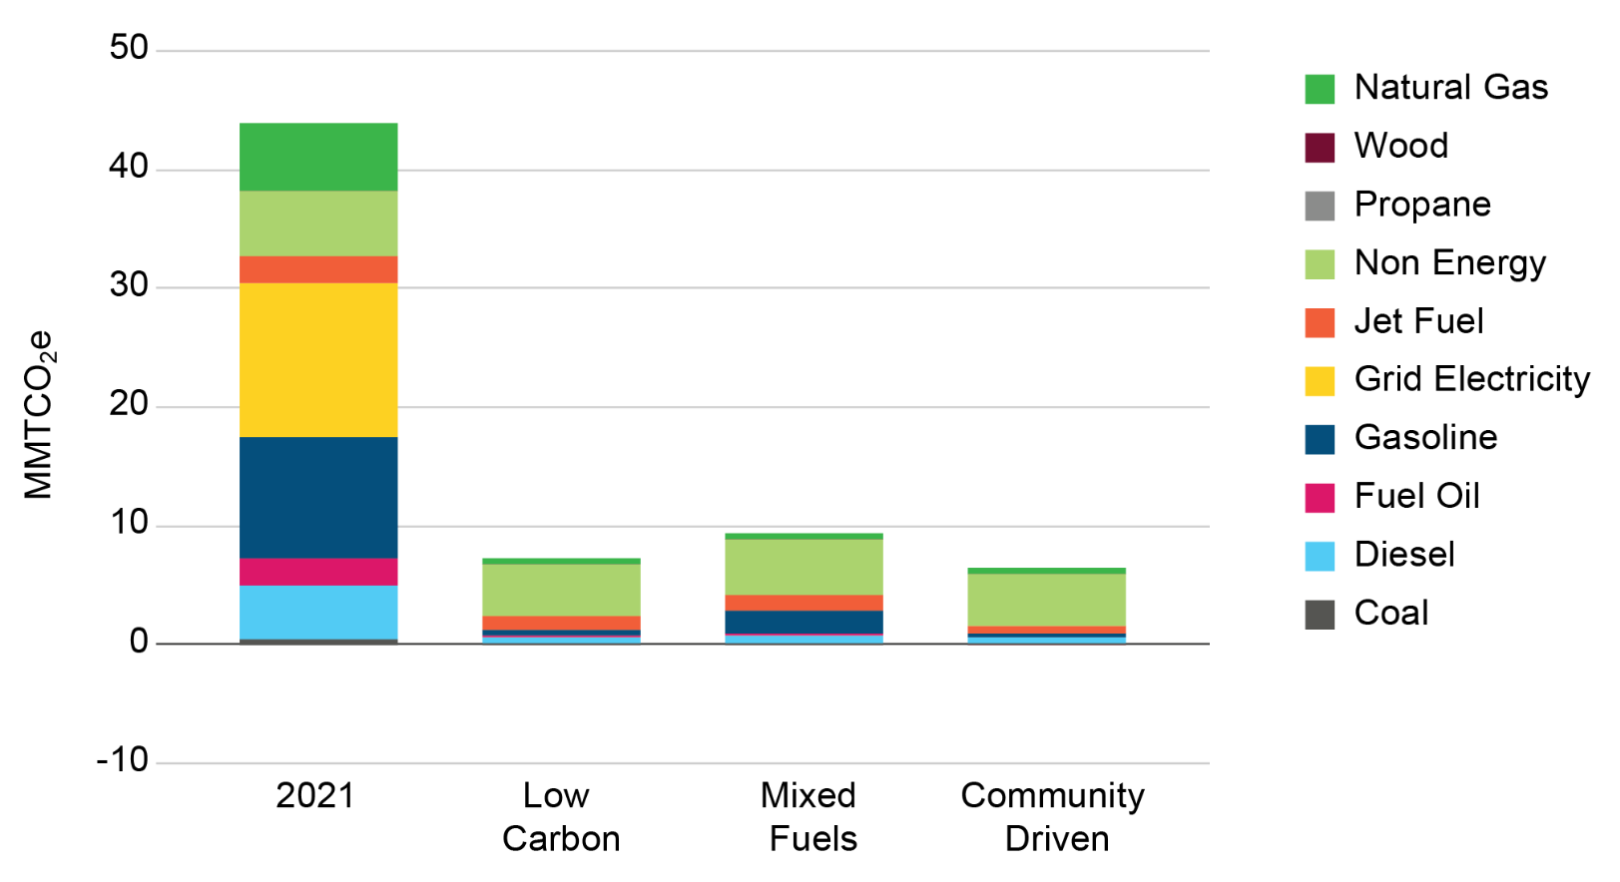
Scenario Comparison
Total Emissions for Each Scenario by Energy Source, 2050
6
Notes:
The energy mix provides an insight. These are the same scenarios but now we are looking a the source of energy for each scenario. First thing to note is that consumption has declined by ⅓ in the low carbon scenarios, using less energy means spending less money. Consumption has declined because low carbon technologies are more efficient; heat pumps use ¼ as much energy to produce the same amount of heat as a natural gas furnace. Electric cars use ⅓ or ¼ as much energy as gasoline cars. The second notable difference is that the energy system is electrified in all three scenarios; electrification of heating and transportation replaces gasoline and natural gas use.

Slide 29

Q+A
Questions or clarifications?
Add your questions to the chat or raise your hand.

Slide 30
Opportunity Areas
Photo taken and owned by NDCNR, permission granted to NDEP

Slide 31

Opportunity Areas
The CCAN scenarios identify eleven strategic “Opportunity Areas” that collectively address the key sources of emissions and define the structural changes needed to decarbonize Nevada.
Energy Systems
Power Nevada with Clean Energy
Buildings
Build Net-Zero New Buildings
Transform Existing Buildings
Transportation
Move with Active and Public Transit
Accelerate Adoption of Zero Emission Vehicles for All
Drive Sustainable Transport of Goods
Industry
Decarbonize Industry
Waste
Divert and Reuse Waste
Harness Landfill Gas
Agriculture
Make Farming More Sustainable
Natural and Working Lands
Grow Nature-Based Solutions
Notes:
Each Big Move represents a suite of measures that could be implemented to accelerate decarbonization while delivering economic and health benefits. Implementation mechanisms, authorities and timelines are described in the full report.

Slide 32
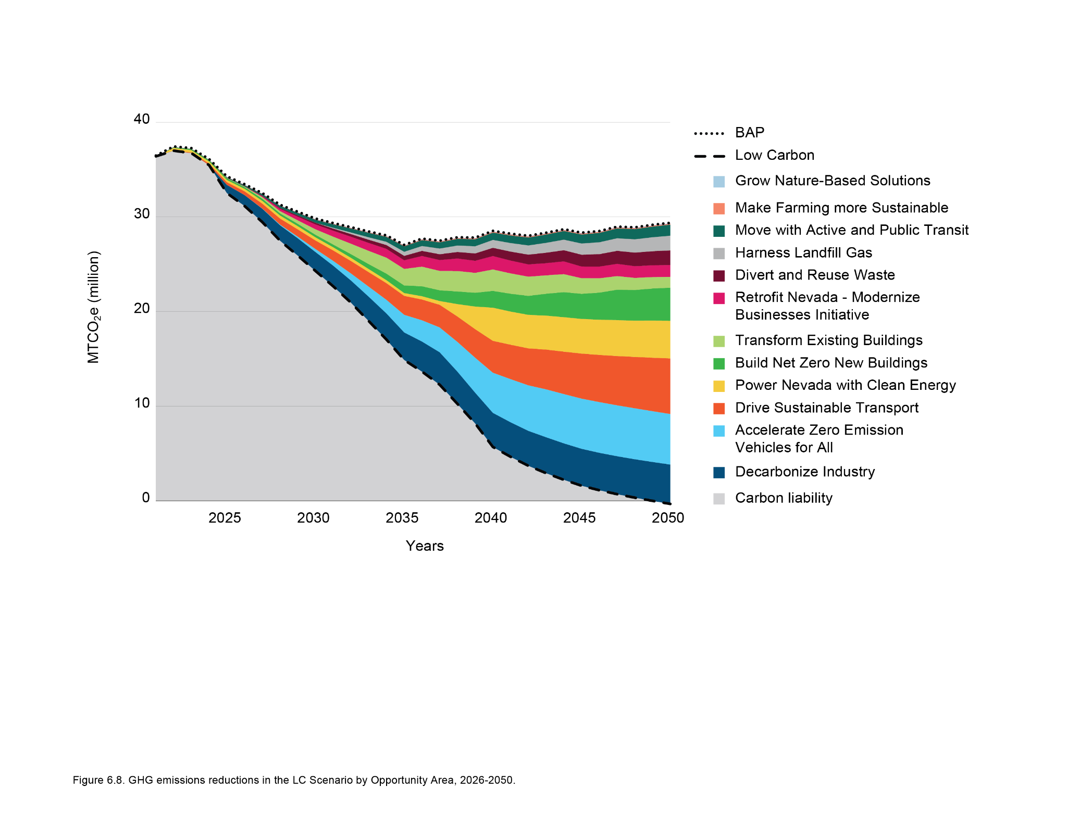
Low Carbon Scenario
Wedge
Diagram
6

Slide 33
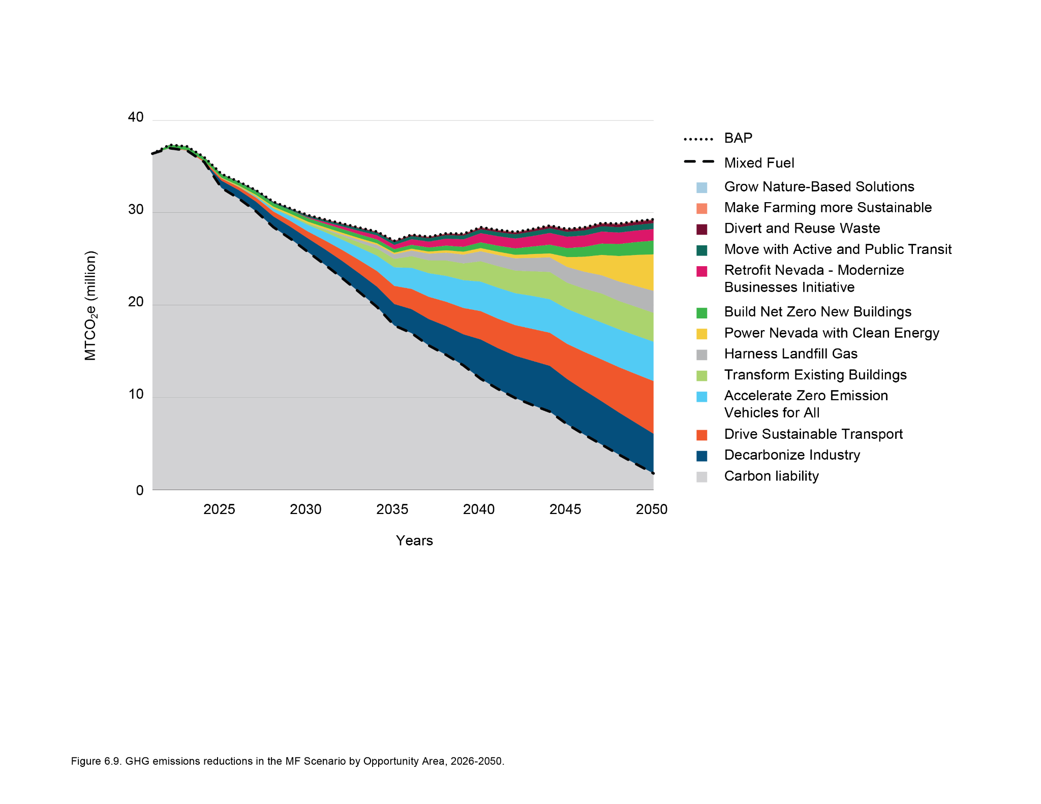
Mixed Fuels Scenario
Wedge
Diagram
6

Slide 34
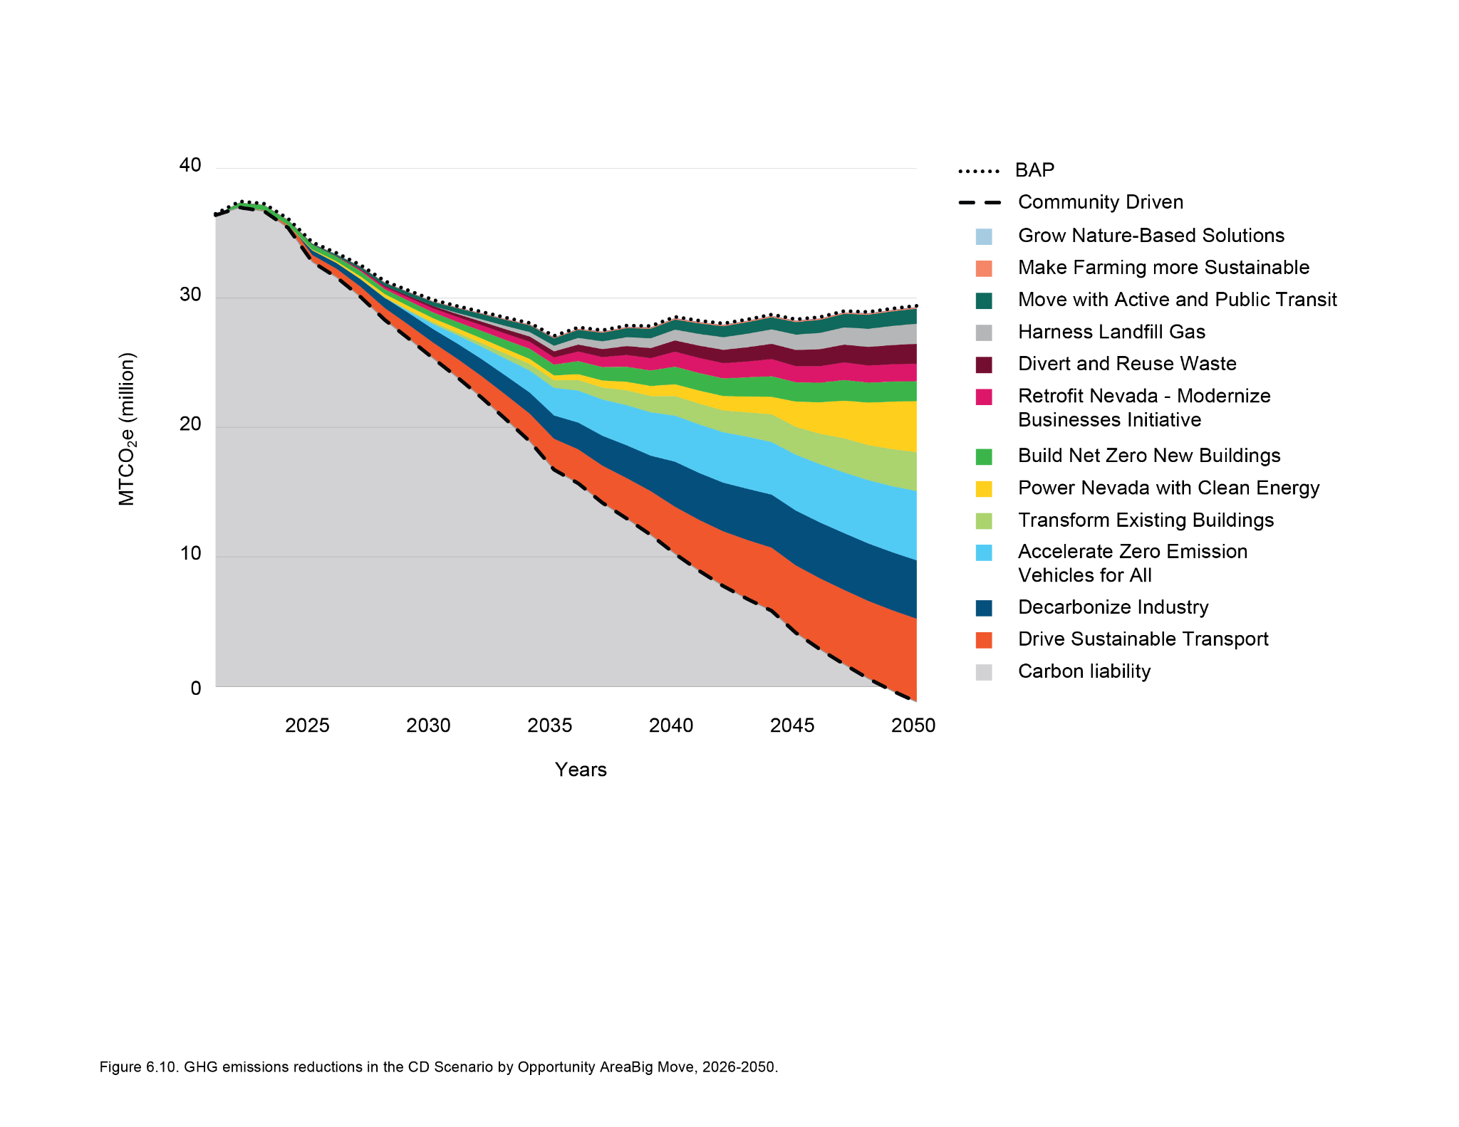
Community-Driven Scenario
Wedge
Diagram
6

Slide 35
Measure to Implementation
Every measure proposed in the CCAN has a suggested pathway to implementation.
This includes:
Measure Title and Description
A brief explanation of the action
Authority to Implement
An overview of which agencies or entities currently have the legal authority to support or carry out the measure.
Key Entities and Roles
A summary of the organizations or institutions that could lead or support implementation.
Implementation Mechanisms
Examples of specific programs, policies, or regulatory tools.
6

Slide 36
Measure to Implementation
Every measure proposed in the CCAN was provided a suggested pathway to implementation.
This includes:
Potential Implementation Timeline and Milestones
Illustrative milestones and dates to show how the measure could roll out over time
Costs and Savings Estimates:
An overview of potential costs and benefits, including the abatement cost and return on investment.
Funding Strategies:
A list of potential federal, state, and private financing mechanisms that could support implementation, including grants, tax credits, and loan programs.
Metrics for Tracking Progress:
Key indicators to assess whether the measure is delivering intended outcomes.
6

Slide 37
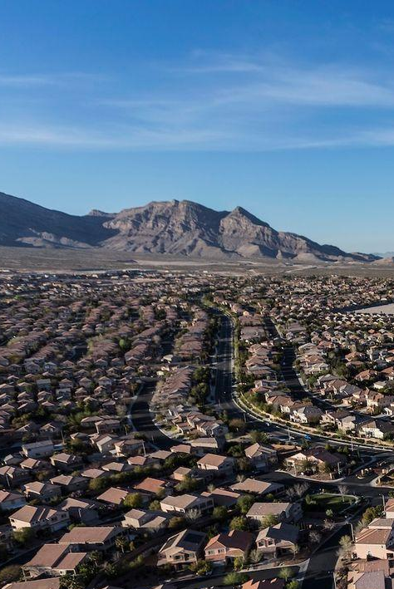
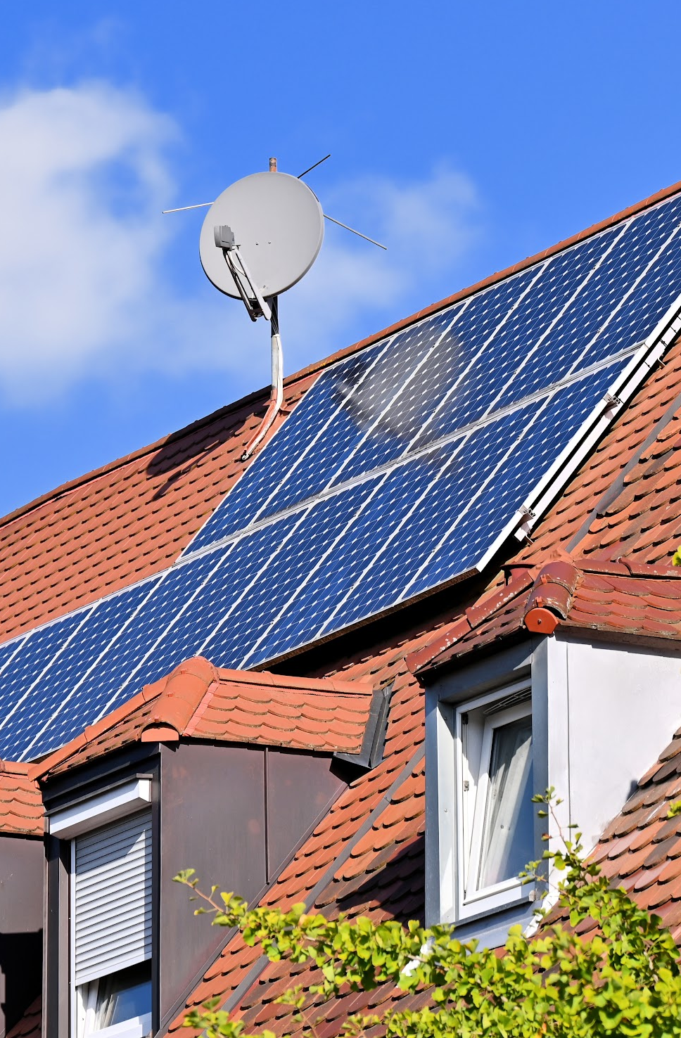
Q+A
Questions or clarifications?
Add your questions to the chat or raise your hand.

Slide 38
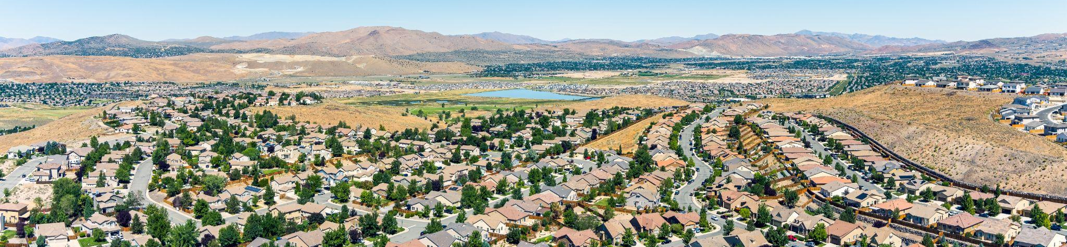
Community Benefits
Photo taken and owned by NDCNR, permission granted to NDEP

Slide 39
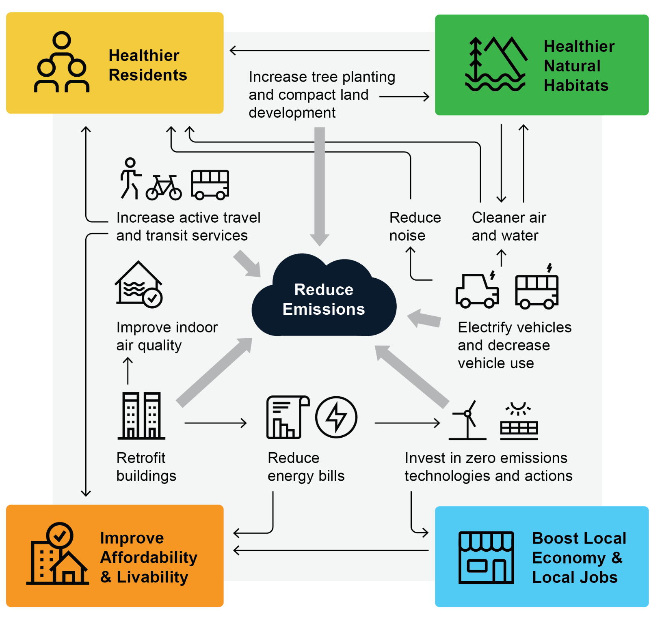
Co-Benefits
Measures that can reduce emissions can also support:
healthier residents
healthier natural habitat
improve affordability & livability
boost local economy and local jobs
6
Notes:
“While our primary goal is to reduce emissions, many of the modeled measures also support public health, economic opportunity, affordability, equity, and quality of life.”
“These benefits are especially important when communicating the value of climate action to communities, businesses, and decision-makers who may be more focused on near-term impacts.”
“We’ll look at a few major co-benefit areas today:
Energy affordability—how climate measures can lower utility and transportation costs for households,
Job creation—how investments in clean energy, retrofits, and infrastructure can create good-paying jobs across the state,
And air quality and health benefits, which are particularly important for vulnerable and overburdened communities.”
“Importantly, these co-benefits are often localized and immediate, meaning they can build public support and political momentum—even before the long-term climate goals are achieved.”

Slide 40
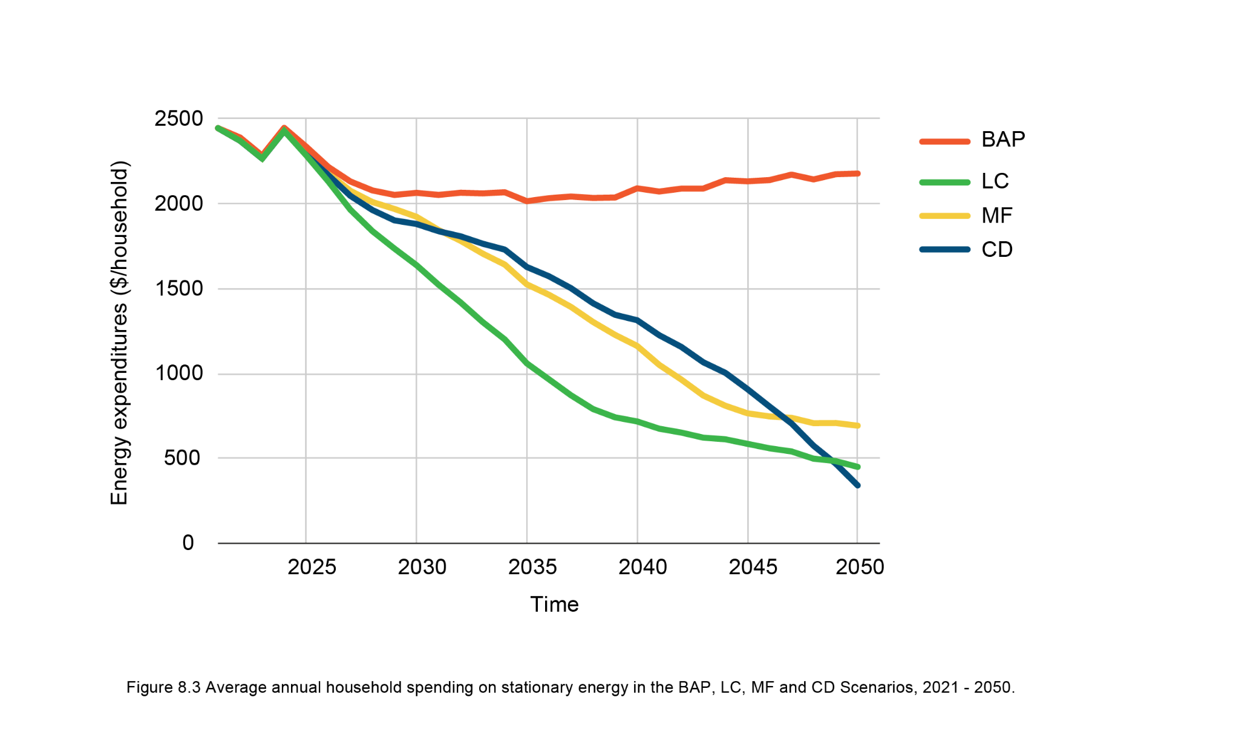
Household Spending
Average annual spending on stationary energy in each scenario (2021 - 2050)
$2,450
$2,180 - BAP
$690 - MF
$450 - LC
$340 - CD
6
Notes:
A household faces a high energy burden when it spends more than 6% of its income on energy.
Cost-effective energy efficiency measures, such as improving insulation and installing more efficient appliances, have the potential to reduce energy use by 13-31%.

Slide 41
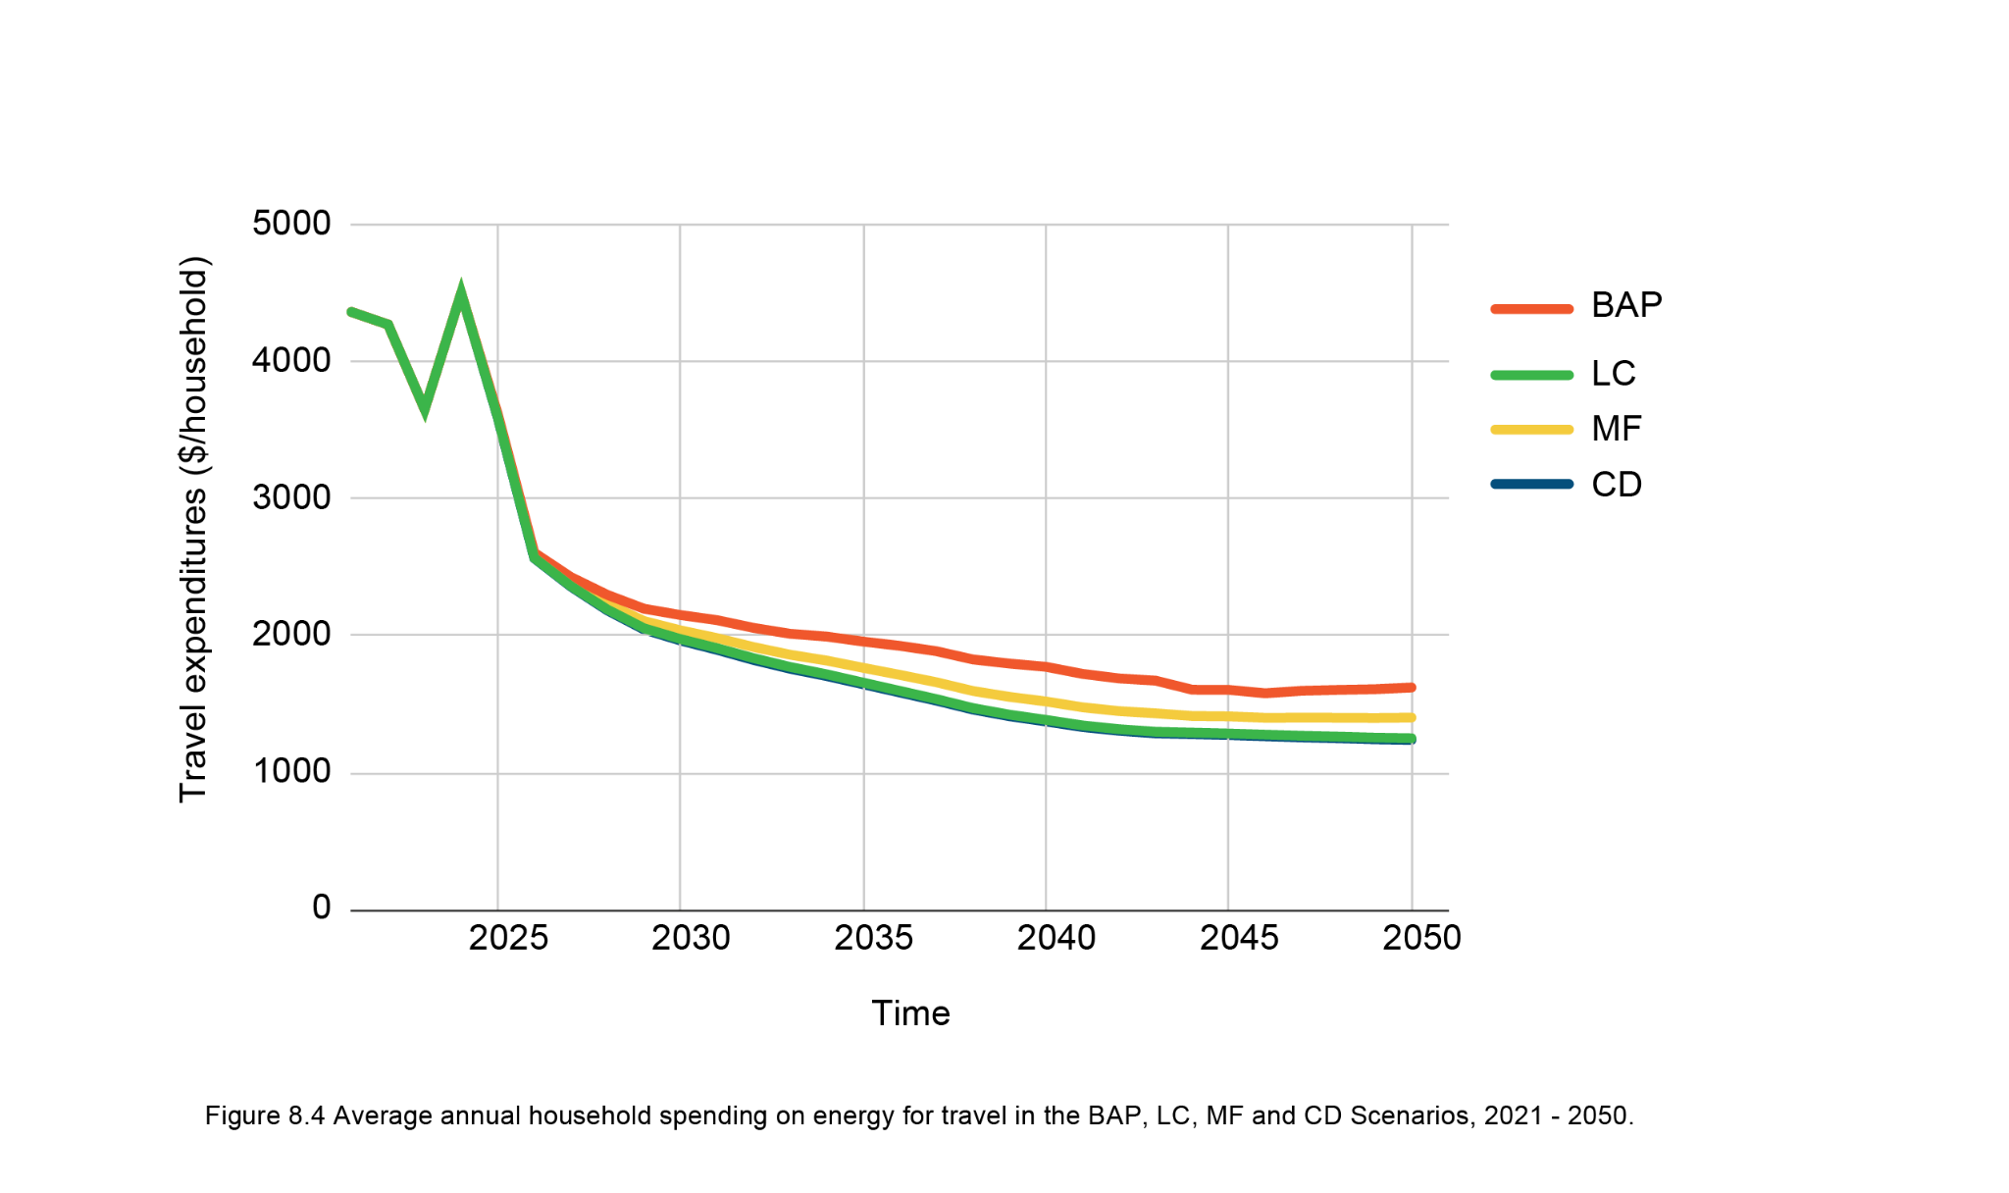
Household Spending
Average annual spending on energy for travel in each scenario (2021 - 2050)
$4,500
$1,620 - BAP
$1,400 - MF
$1,250 - LC
$1,240 - CD
6
Notes:
Transit-oriented urban development can reduce per capita use of automobiles by 50%, reducing household transport expenditures by 20%.

Slide 42
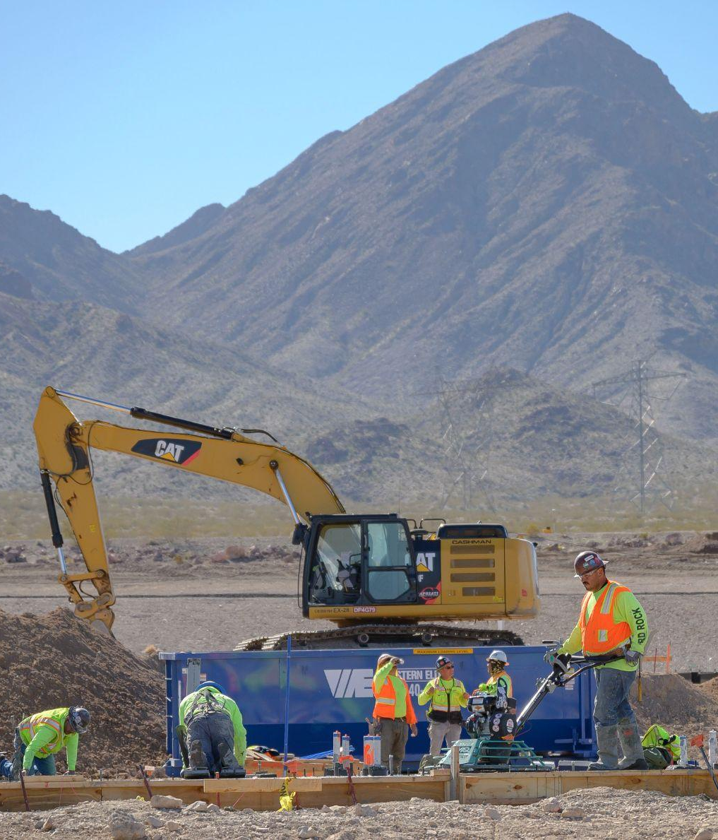
Employment Impacts
The average annual years of employment, relative to Business-as-Planned was calculated in each scenario:
Under the Low Carbon Scenario, 19,000 jobs are projected per year between 2026 - 2050, the most jobs out of all three scenarios
Under the LC and MF Scenarios, the most jobs fall under the Opportunity Area: Transform Existing Buildings followed by the Opportunity Area: Decarbonize Industry
In the Community Driven Scenario: Opportunity Areas Power Nevada with Clean Energy and Move with Active and Public Transit will create the most jobs.
6
Due to data limitations no estimates have been provided for “Divert and Reuse Waste”, and “Harness Landfill Gas”.

Slide 43
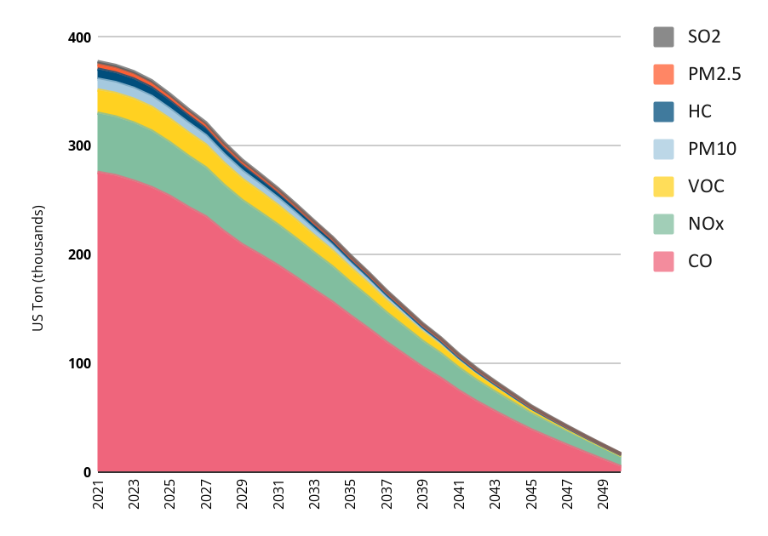
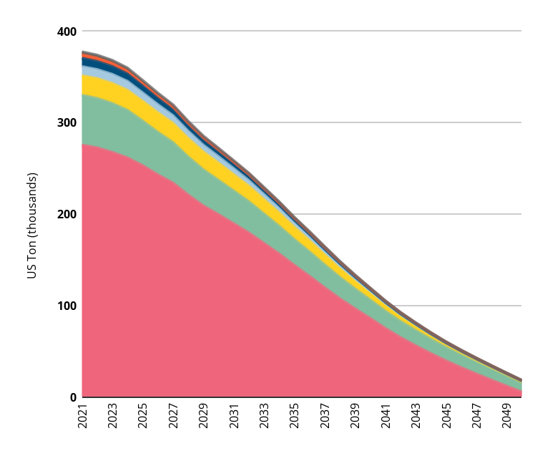
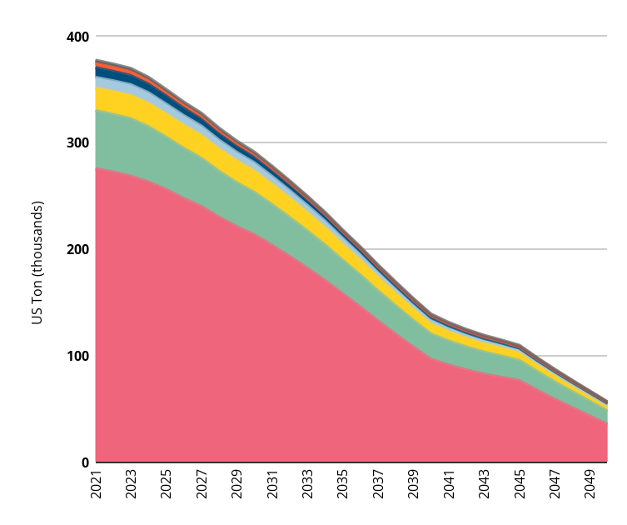
Co-Pollutant Reductions
Comparing Scenarios
LC
MF
CD
Nearly identical pollutant reductions would be achieved in the LC and CD scenarios.
6
Notes:
“Co-pollutants include harmful substances like particulate matter (PM2.5), nitrogen oxides (NOx), sulfur dioxide (SO₂), and carbon monoxide (CO)—all of which are emitted alongside greenhouse gases in sectors like transportation, industry, and energy.”
“These pollutants are directly linked to respiratory illness, heart disease, and premature death, particularly in vulnerable populations such as children, the elderly, and those living near highways or industrial areas.”
“By shifting to zero-emission vehicles, electrifying buildings, and cleaning up our electricity grid, we not only reduce carbon emissions but also clean the air Nevadans breathe every day.”
“This is one of the most immediate and local benefits of climate action. While the climate benefits play out globally and over time, air quality improvements are local and nearly immediate.”
“We’ll now take a look at how these co-pollutant reductions vary across scenarios, and where the greatest health benefits may occur.”

Slide 44
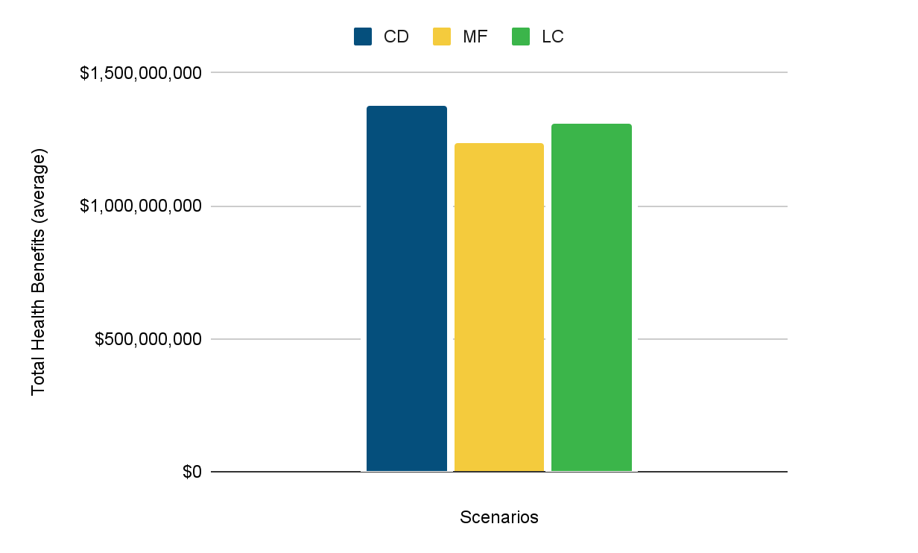
Total Health Benefits ($)
Using the EPA CO-Benefits Risk Assessment Health Impacts Screening and Mapping Tool (COBRA)
Total Health Benefits includes:
avoided costs and incidences due to reduced air pollution of estimated mortalities for infants
non-fatal heart attacks
hospital and ER admissions for respiratory issues
asthma-related costs
work loss days
school loss days
restricted activity days

Slide 45
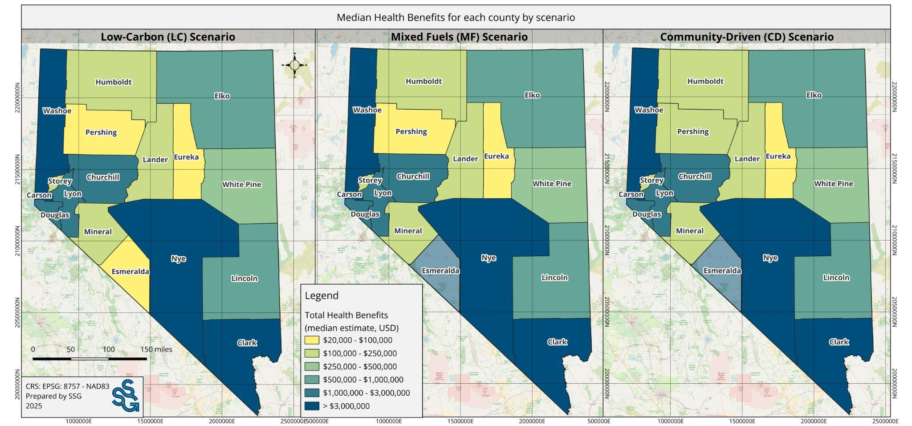
Total Health Benefits ($)
Using the EPA CO-Benefits Risk Assessment Health Impacts Screening and Mapping Tool (COBRA)*

Slide 46
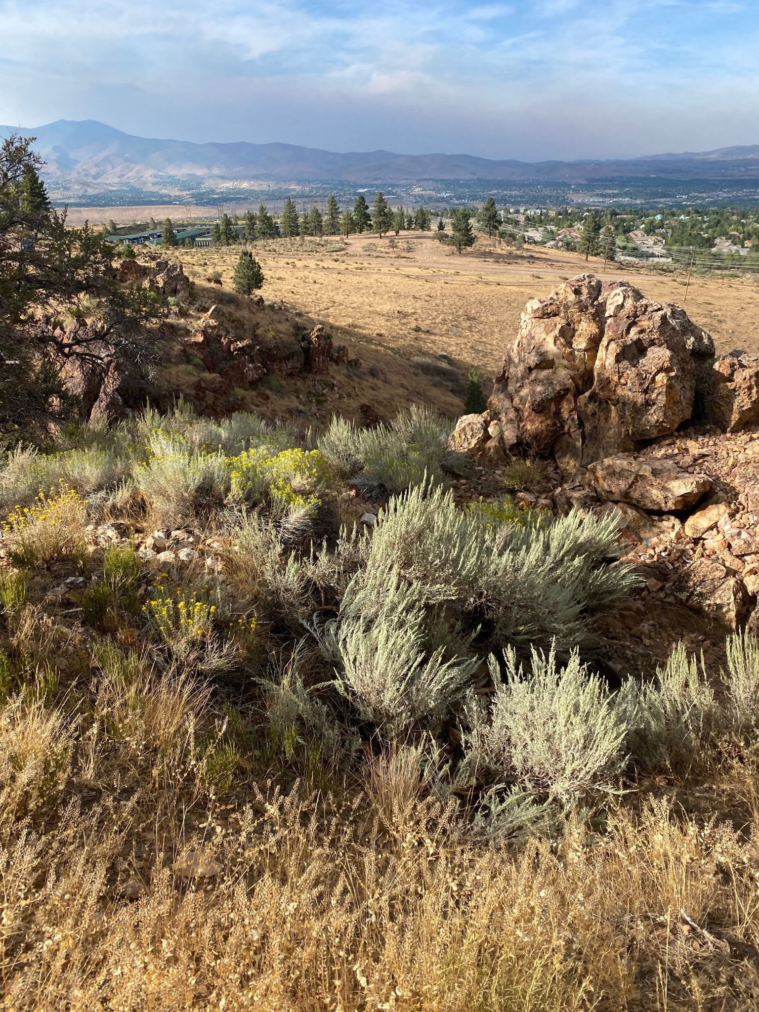
Q+A
Questions or clarifications?
Add your questions to the chat or raise your hand.

Slide 47
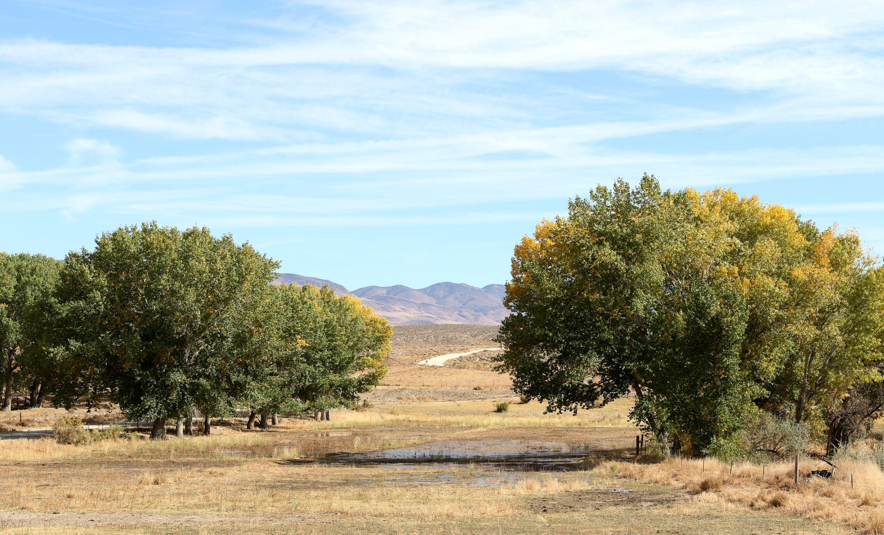
Closing
Photo taken and owned by NDCNR, permission granted to NDEP

Slide 48

Next Steps
There will be Status Report on the CCAN in 2027.

Slide 49

Thank You
Website:
ndep.nv.gov/air/climate-pollution-reduction-grant
Email: ndep.cprg@ndep.nv.gov

Slide 50
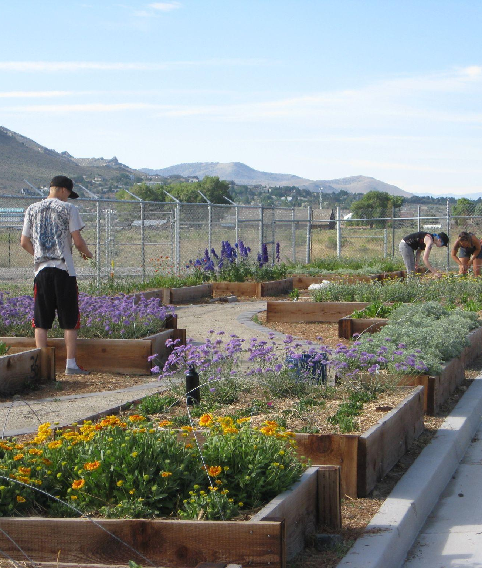

Feedback
Link in chat to share additional information and provide feedback about this session.
https://ssgcoop.typeform.com/to/YwX4Q2Aq
Notes:
https://ssgcoop.typeform.com/to/YwX4Q2Aq

Slide 51

Questions?
The team is here to answer any remaining questions you may have on the CCAN!

Slide 52

Extra Slides
Notes:
Kayla

Slide 53
Community Benefits to Reducing GHG Emissions
Reduce Household Energy Costs:
Household Energy spending can reduce up to 84% in 2050 (Community-Driven Scenario)
Household Travel expenses can be reduce up to 23% in 2025 (Community-Driven Scenario)
Increased Green Job Growth
Over 19,000 jobs are projected per year between 2026 - 2050 (Low Carbon Scenario)
New job projected to be generated in measures: Transforming Existing Buildings and Decarbonizing Industry
Cleaner Air
Co-pollutants (including CO, Nox, VOC, PM10, HC, Pm2.5 and ) can be reduced up to 95% in 2050
(Low Carbon Scenario)
Improved Public Health
Using the EPA COBRA tool, the cumulative effects of all measures would result in total health benefits of approximately $1.4 billion annually by 2050 (Community Drive Scenario).
6
Notes:
Yuill

Slide 54
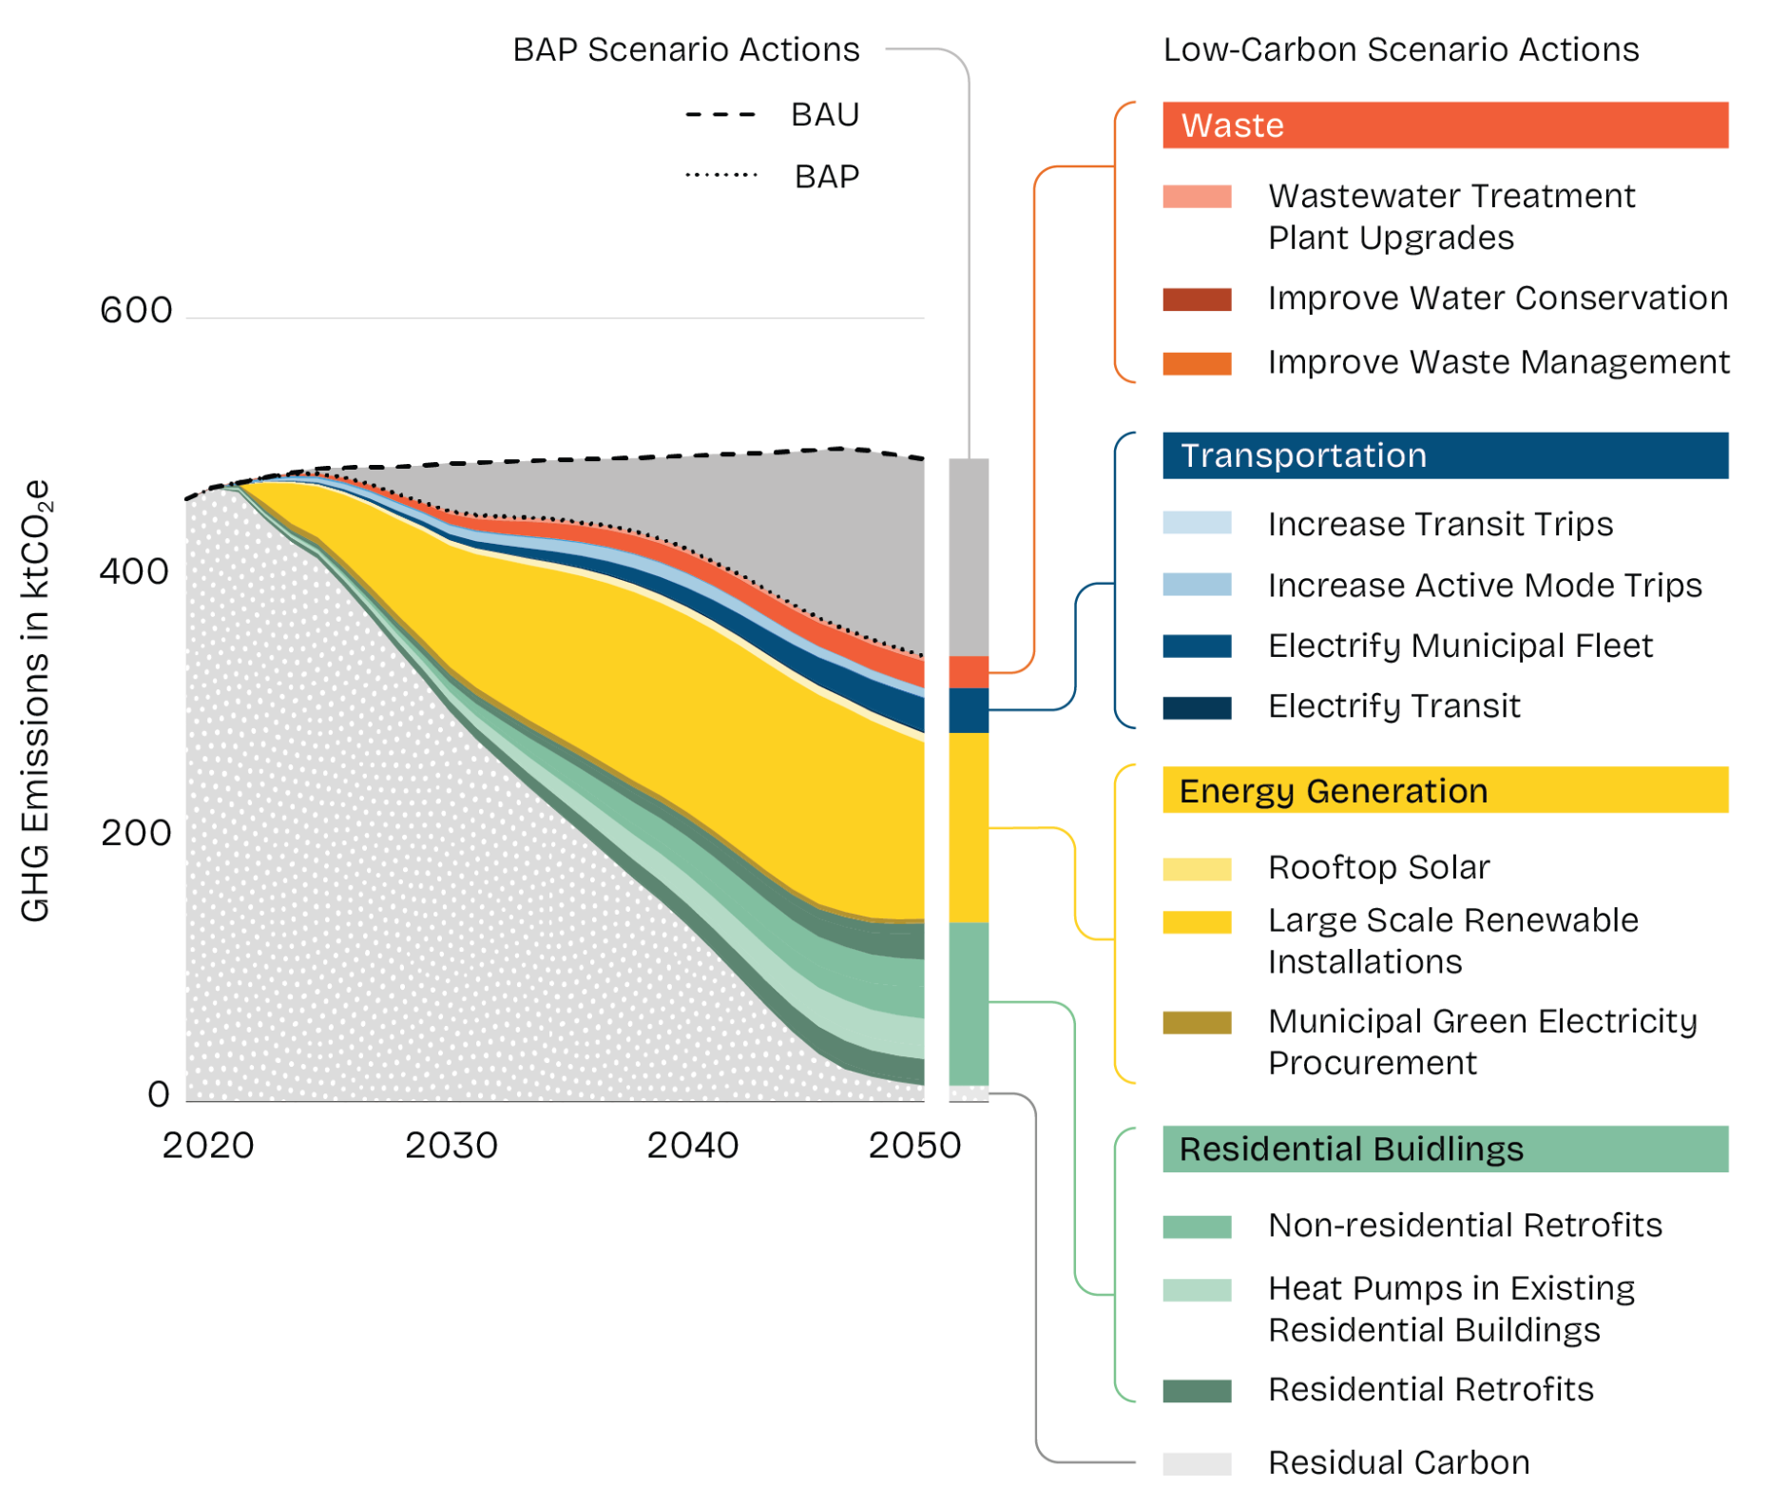
How To Build a
Scenario
Colored wedges show the emission reduction potential of specific measures for each scenario.
Notes:
Yuill

Slide 55
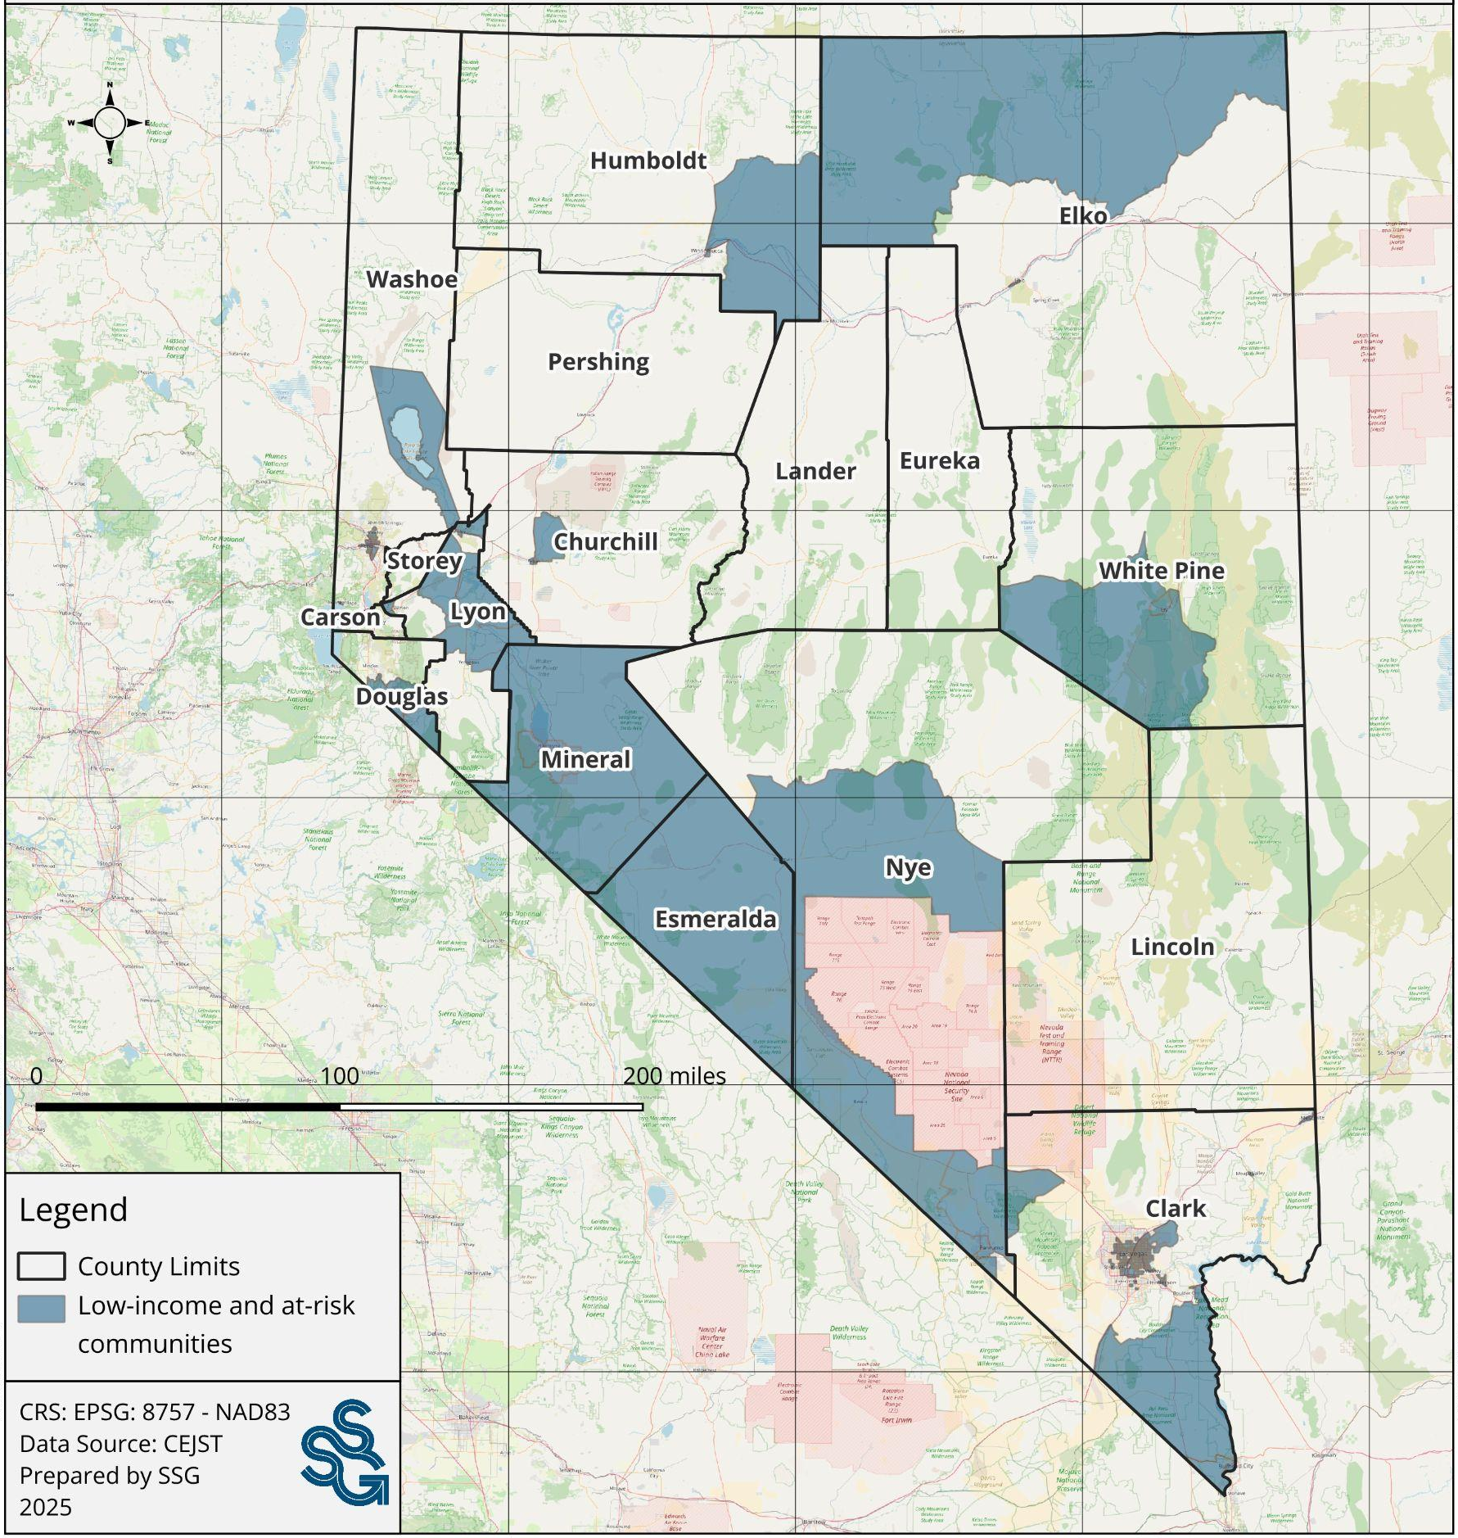
Low-Income Areas
In the Community Driven Scenario, actions are focused on prioritizing the most vulnerable and at-risk communities.
6
Notes:
Yuill

Slide 56
Scenarios Comparison
Photo taken and owned by NDCNR, permission granted to NDEP
Notes:
Yuill

Slide 57
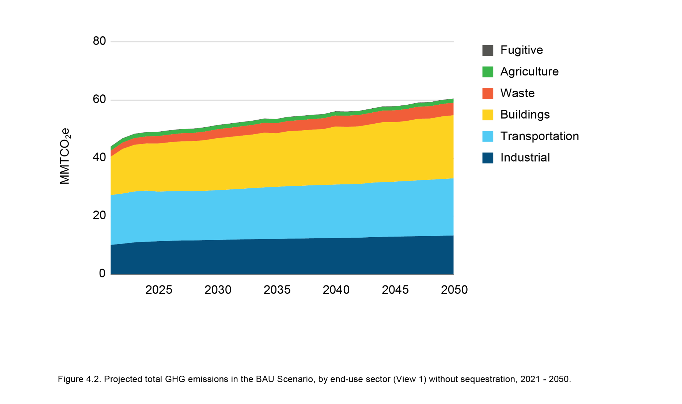
BAU
“Business-As-Usual”
Reference Scenario
Continuation of current trends including population growth and economic growth with no additional policies.
Under the BAU scenario, emissions are projected to rise 45% by 2050.
6
Notes:
Yuill

Slide 58
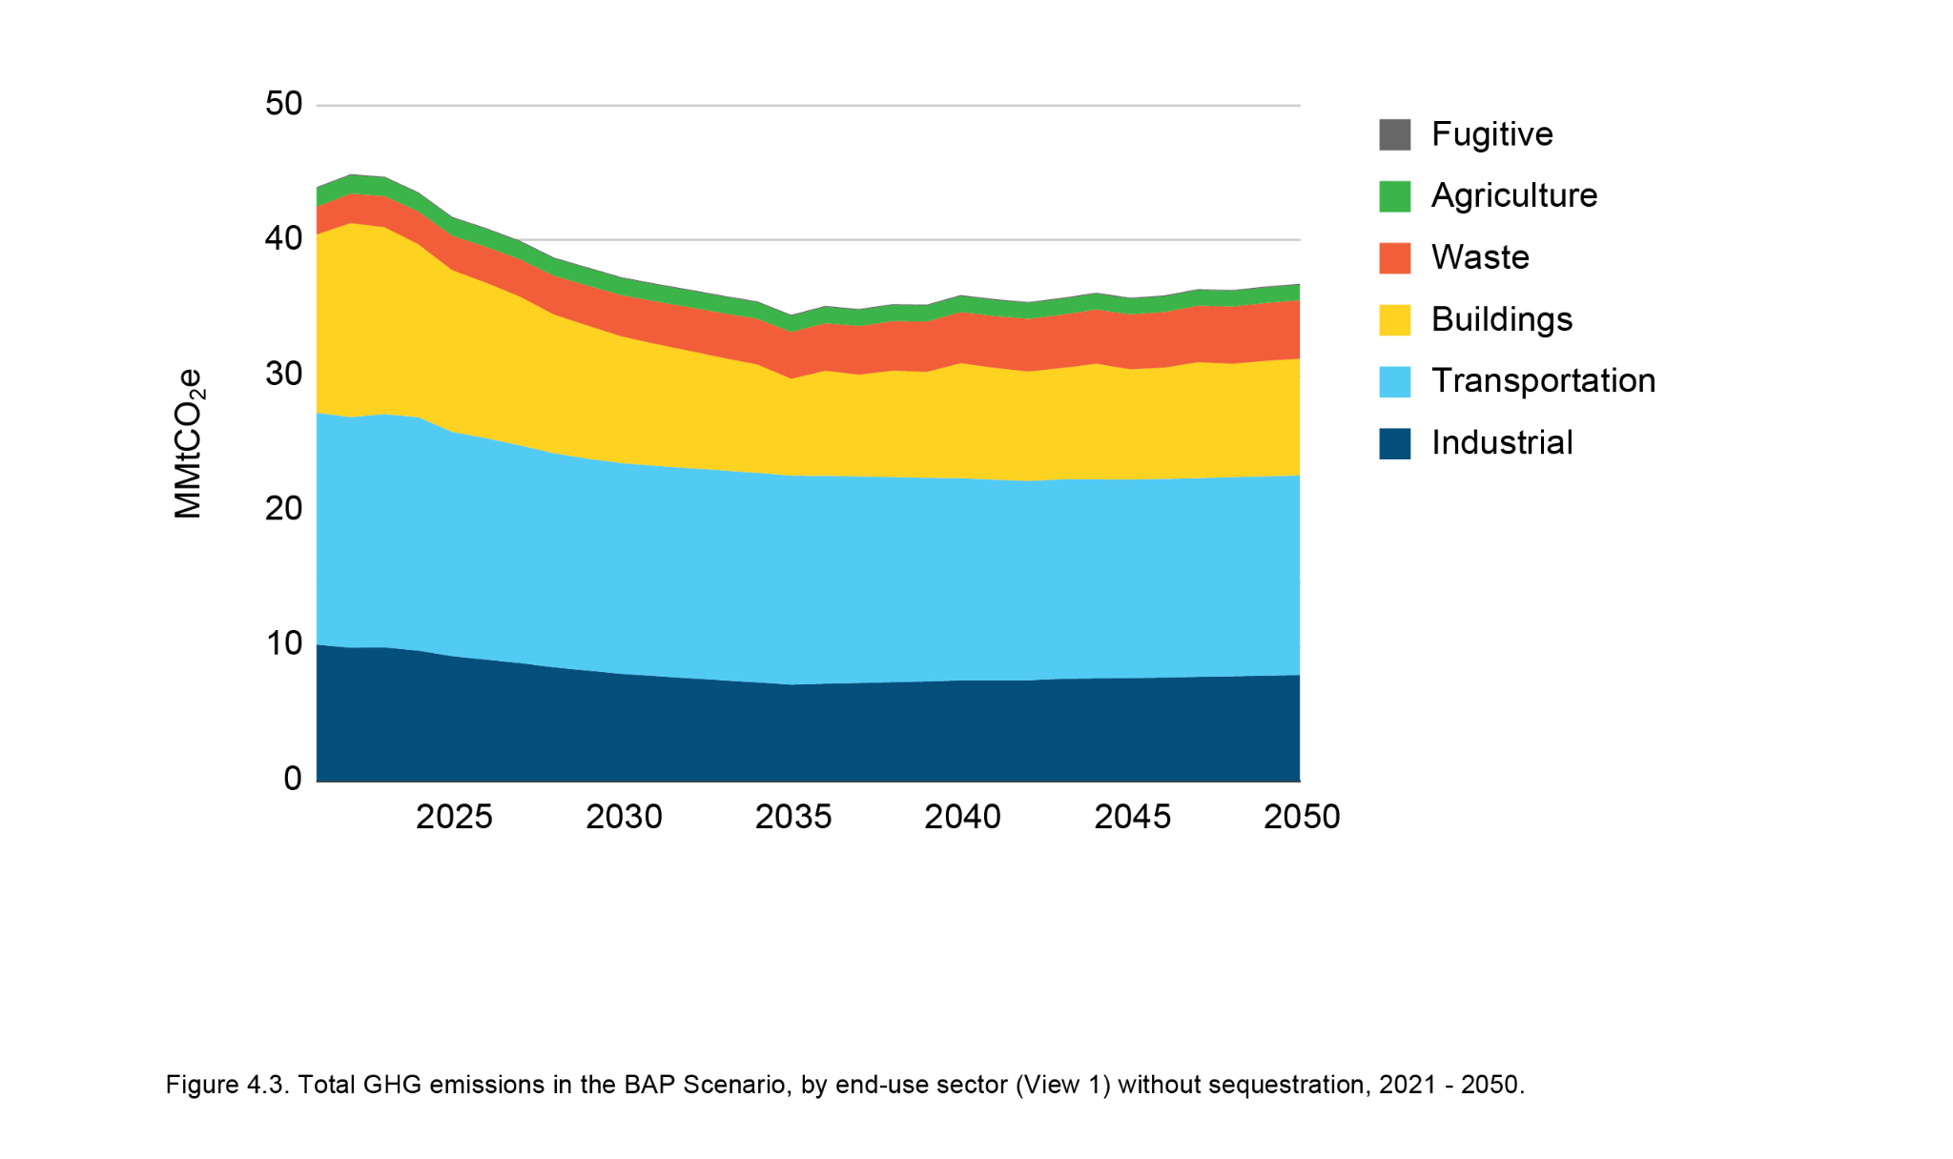
BAP
“Business-As-Planned”
Reference Scenario
Full implementation of current and on the books policies and programs.
The BAP scenario projects a 20% decline in net emissions by 2050, driven by existing policies and planned investments such as renewable energy adoption, particularly in the building sector.
6
Notes:
Yuill

Slide 59
Opportunity Areas
Notes:
Kayla

Slide 60
Energy
Opportunity Area & Measures
Power Nevada with Clean Energy | Paths to a Clean, Renewable, Reliable, and Resilient Grid for Nevada
 | Expand Residential Solar Access and Affordability with Financing and Technical Support Programs
 | Adopt Initiatives Supporting Community Solar and Renewable Co-ops
 | Scale Up Solar Installation in Commercial Sector with Financing and Technical Support Programs
Notes:
Kayla
Key Assumptions:
Accelerated clean electricity grid in Low Carbon Scenario, slower to transition in Mixed Fuels and Community Driven
Residential and commercial solar installation increases in new buildings aligned with net zero building energy code adoption
Increased on-site solar installation in existing buildings in Low Carbon and Community Driven scenarios. Slower adoption in Mixed Fuels
Community solar is accelerated in Community Driven Scenario

Slide 61
Buildings
Opportunity Areas & Measures
Build Net Zero New Buildings | Strengthen Building Energy Conservation Codes
 | Adopt Net-Zero Ready Standards for All New Buildings
 | Invest in Zero-Emission Affordable Housing Options
Transform Existing Buildings | Establish Building Performance Standards for Existing Large Buildings
 | Retrofit Nevada - Modernize Homes Initiative
 | Retrofit Nevada - Modernize Businesses Initiative
 | Incentivize and Require Heat Pumps for Heating and Cooling in Residential Buildings
 | Incentivize and Require Heat Pumps for Heating and Cooling in Commercial Buildings
Notes:
Key assumptions: Net zero building energy code implemented
CD - 2027, LC - 2030, MF - 2036
Residential buildings and commercial retrofits across scenarios
CD focus on retrofitting low income areas first
Community Land Trusts and Zero-emissions rental housing options in CD
In all scenarios
Local governments adopt IECC at the same rate as the State
Building Performance Standards
Heat pump deployment in residential and commercial buildings, including replacing AC units with heat pumps

Slide 62
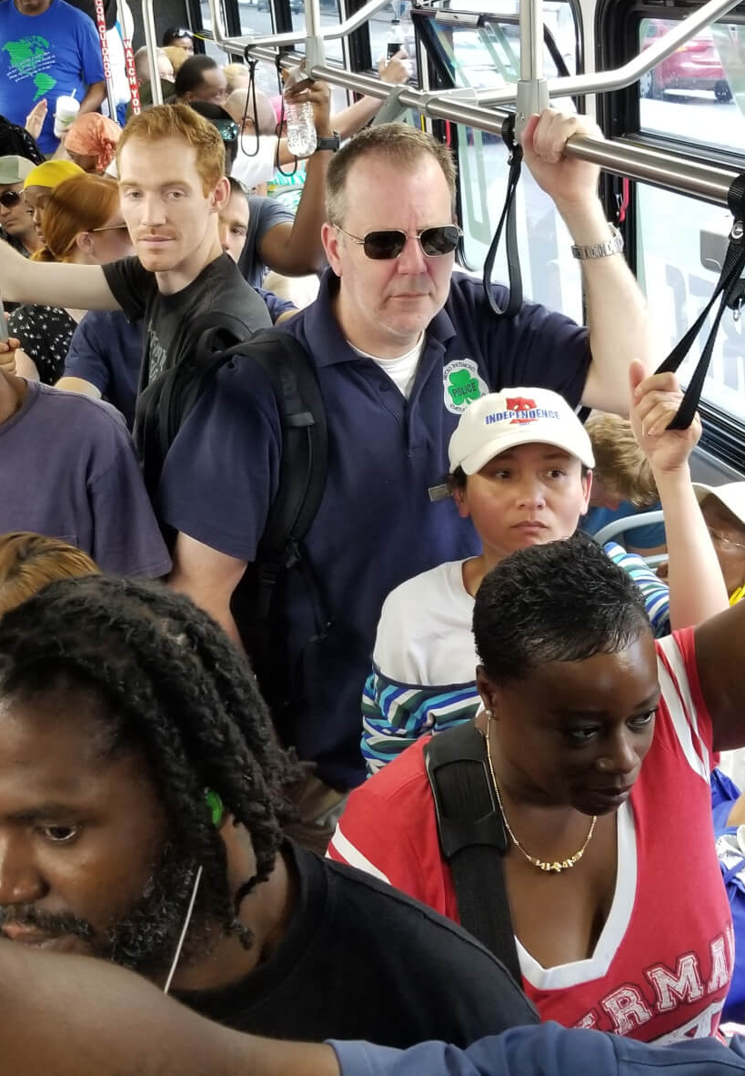
Transportation
Opportunity Areas & Measures
ZEV = Zero Emission Vehicle
Move with Active and Public Transit | Build Public Transit and Active Transportation Networks for Everyone
Accelerate Adoption of Zero Emission Vehicles for All | Launch ZEV for NV, an initiative to increase personal use ZEVs
 | Establish Lead the Charge, an Electrifying Public Fleets Assistance Program
 | Deploy Community-Based Electric Car Sharing Programs
Drive Sustainable Transport of Goods | Incentivize and Require the Clean Commercial Fleet Transition
 | Adopt Power Up Clean Worksites, an initiative to transition Off-Road Equipment to ZEVs
 | Fuel Sustainable Skies Program
 | Propel Marine Vessels to use Low- and Zero-Emission Fuels
Notes:
Key assumptions: Most ambitious active/transit mode share shifts in Community Driven Scenario
Accelerated electrification of personal use vehicles in Community Driven and Low Carbon Scenarios
More hydrogen vehicles and slower transition to ZEVs in Mixed Fuels Scenario
Community Driven Scenario also increase hydrogen use at a higher rate
Car sharing program in Community Driven Scenario
Increased use of SAF in Community Driven Scenario to reduce resident exposure to jet fuel.
In all scenarios:
Transitioning off road vehicles and marine vessels
Expanding charging infrastructure

Slide 63
Industry
Opportunity Area & Measures
Decarbonize Industry | Maximize Industrial Energy Efficiency
 | Accelerate Deployment of Green Hydrogen for Industrial Decarbonization
 | Electrify Industrial Processes and Integrate On-Site Renewables
 | Support Industrial Carbon Capture, Utilization, and Storage (CCUS) Solutions
Notes:
Maximization of industrial energy efficiency accelerated in the Low Carbon Scenario
Accelerated energy efficiency and electrification in Low Carbon Scenario.
Increased hydrogen use in Mixed Fuels and Community Driven Scenarios
Community Driven Scenario accelerates electrification of industrial processes and on-site renewables
All scenarios adopt carbon capture, utilization, and storage solutions on the same timeline

Slide 64
Waste
Opportunity Areas & Measures
Divert and Reuse Waste | Expand recycling, composting, and sustainable materials management programs
Harness Landfill Gas | Develop and Fund Landfill Gas Capture and Utilization Systems
Notes:
Mixed Fuels Scenario has the most landfill gas capture
Community Driven Scenario makes landfill gas capture accessible to larger population centres
Higher rates of recycling and composting achieved in Low Carbon & Community Driven Scenarios

Slide 65
Agriculture
Opportunity Area & Measures
Make Farming more Sustainable | Grow Regenerative Agriculture Practices in Nevada
 | Improve Grazing Management and Rangeland Resilience
Notes:
Agricultural lands are converted from conventional tillage to no-till and cover crop practices with the highest percentage being in the Low Carbon and Community Driven Scenarios
Grazing management is improved on rangelands with the highest percentage being in the Low Carbon and Community Driven Scenarios

Slide 66
Natural and
Working Lands
Opportunity Area & Measures
Grow Nature-Based Solutions | Expand Urban and Community Tree Canopy Coverage Across Nevada
 | Protect and Restore Natural Lands Initiative
Notes:
Key Assumptions:
Cities to increase tree canopy cover to 30%
Prioritization of increased tree canopy cover in low income areas for the Community Driven Scenario
Protection and restoration of sagebrush and forested land in all three scenarios

Slide 67
Benefits Analysis
Notes:
Kayla

Slide 68
Co-Benefits
Measures that can reduce emissions can also support healthier residents and natural habitats, boost local economies, create local jobs and improve affordability and livability.
6
Notes:
Kayla
“While our primary goal is to reduce emissions, many of the modeled measures also support public health, economic opportunity, affordability, equity, and quality of life.”
“These benefits are especially important when communicating the value of climate action to communities, businesses, and decision-makers who may be more focused on near-term impacts.”
“We’ll look at a few major co-benefit areas today:
Energy affordability—how climate measures can lower utility and transportation costs for households,
Job creation—how investments in clean energy, retrofits, and infrastructure can create good-paying jobs across the state,
And air quality and health benefits, which are particularly important for vulnerable and overburdened communities.”
“Importantly, these co-benefits are often localized and immediate, meaning they can build public support and political momentum—even before the long-term climate goals are achieved.”

Slide 69
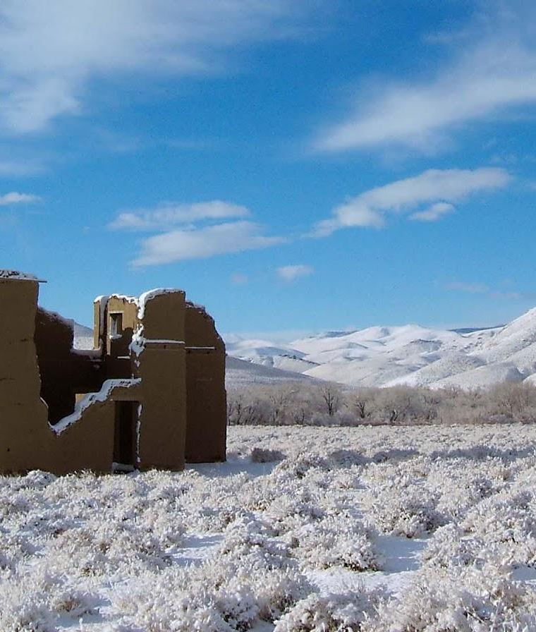
Q+A
Questions or clarifications?
Add your questions to the chat or raise your hand.
Menti: What co-benefits are you most excited about?
Go to www.menti.com
and enter code 7527 1865

Slide 70
Financial Analysis
Photo taken and owned by NDCNR, permission granted to NDEP
Notes:
Yuill

Slide 71
Concepts & Definitions
Financial Analysis
All costs are relative to the Business-As-Planned (BAP) Scenario
The economic analysis tracks projected costs and savings associated with low-carbon measures above and beyond the costs in the BAP Scenario.
4 aggregated categories for financial performance of low-carbon measures:
1. Capital Expenditure
2. Energy Savings (or Costs)
3. Operation and Maintenance Savings (O&M)
4. Revenue Generation
Notes:
Yuill
It’s important to know that we’re comparing all costs and savings relative to the Business-As-Planned scenario, or BAP. That’s what would happen if Nevada continues with current and planned policies without additional climate measures.
“We group the financial impacts into four key categories to make this easier to understand and compare across actions:
Capital Expenditure – This is the up-front investment cost. Think of things like EV purchases, retrofitting buildings, or installing clean energy systems.
Energy Savings (or Costs) – These are reductions (or increases) in energy bills from using more efficient or cleaner technologies.
Operation and Maintenance (O&M) Savings – Many low-carbon technologies have lower maintenance costs over time—for example, EVs have fewer moving parts than gas-powered vehicles.
Revenue Generation – Predominantly associated with renewable energy production and transportation actions
“By tracking all these elements, we can calculate the net annual financial impact—whether a measure or scenario costs more or saves money each year, and how that changes over time.”

Slide 72
Concepts & Definitions
Financial Analysis
Net Present Value (NPV)
The net present value (NPV) of an investment is the difference between the present value of the capital investment and the present value of the future stream of savings and revenue generated by the investment.
A negative NPV means an investment is expected to generate more value than it costs.
A positive NPV means that a project generates more costs than value.
Notes:
Yuill
“Net Present Value is a common financial tool used to assess the economic return of an investment over time.”
“It’s calculated by taking the difference between the investment’s costs and the value of the future stream of benefits, like savings or revenues.”
“If the NPV is negative, it means the investment is projected to generate more value than it costs—which is a good thing. That might sound counterintuitive, but here, we’re treating avoided costs, like reduced energy costs or fuel expenses, as a form of benefit.”
“If the NPV is positive, the investment is expected to cost more than the value it generates.”
“We apply this approach across each of the modeled climate actions to determine whether they represent a sound financial investment for the state and its communities.”

Slide 73
Concepts & Definitions
Financial Analysis
Discount Rate
The rate at which future costs and benefits are reduced in comparison to current costs and benefits, reflecting the value society places on benefits or costs in the future relative to benefits or costs today.
A higher discount rate means that future effects are much less significant than present effects.
A lower discount rate means that effects are closer to being equally significant.
The social discount rate applied in this analysis is 3%.
Notes:
Yuill
“Another important concept in our financial analysis is the discount rate. This determines how we value future costs and savings relative to today.” It’s the idea that a dollar today is worth more than a dollar in the future—because of inflation, risk, opportunity cost, or generally we usually prefer benefits now rather than later.
“Essentially, the discount rate reflects how much less society values benefits—or costs—that occur in the future compared to the present.”
“A higher discount rate makes future benefits less important. This means projects with long-term savings may appear less financially attractive.”
“Conversely, a lower discount rate gives more weight to long-term outcomes. That’s often appropriate for climate-related investments where many benefits—like avoided health costs or infrastructure damage—accrue decades into the future.”
“For this analysis, we used a 3% social discount rate. This is a standard rate often used in climate economics and reflects federal guidance and global modeling practices.”
“It helps ensure our analysis places meaningful value on long-term savings from reduced emissions, improved health, and avoided climate damages.”

Slide 74
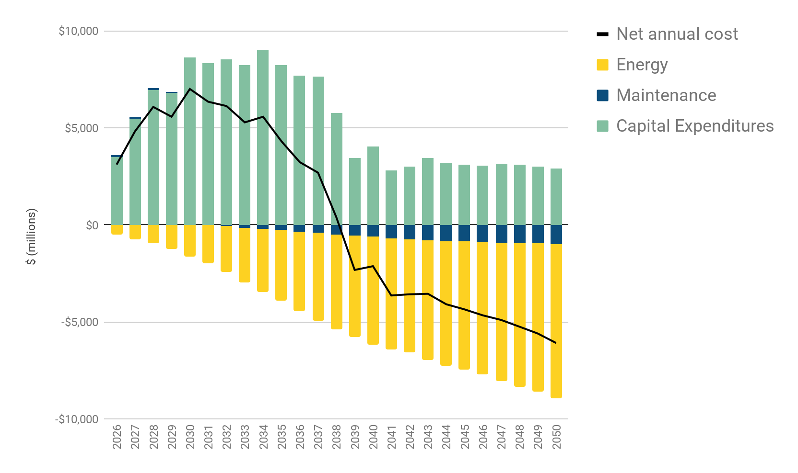
Net Annual Cost or Savings
Annual Investment and Savings in the LC Scenario (2026-2050)
Pivot point
2038
Costs money
Saves money
6
Notes:
Average 5.4 billion per year…
Nevada’s current GDP is 200, approximately 2.8%

Slide 75
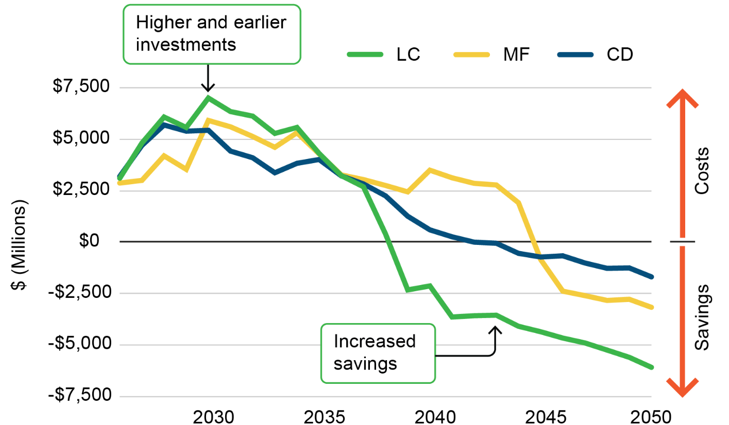
Net Annual Cost or Savings
Comparison of Low Carbon (LC) Mixed Fuels (MF) and Community Driven (CD) Scenarios
6
Notes:
2035
, mf 2045
Yuill
A key takeaway here is that low-carbon pathways tend to require significant capital investment early on, especially in areas like transportation electrification, clean energy infrastructure, and building retrofits.
But while the up-front costs are high, the long-term savings are substantial—and they grow over time as cleaner technologies reduce energy use, lower maintenance needs, and reduce fuel costs.

Slide 76
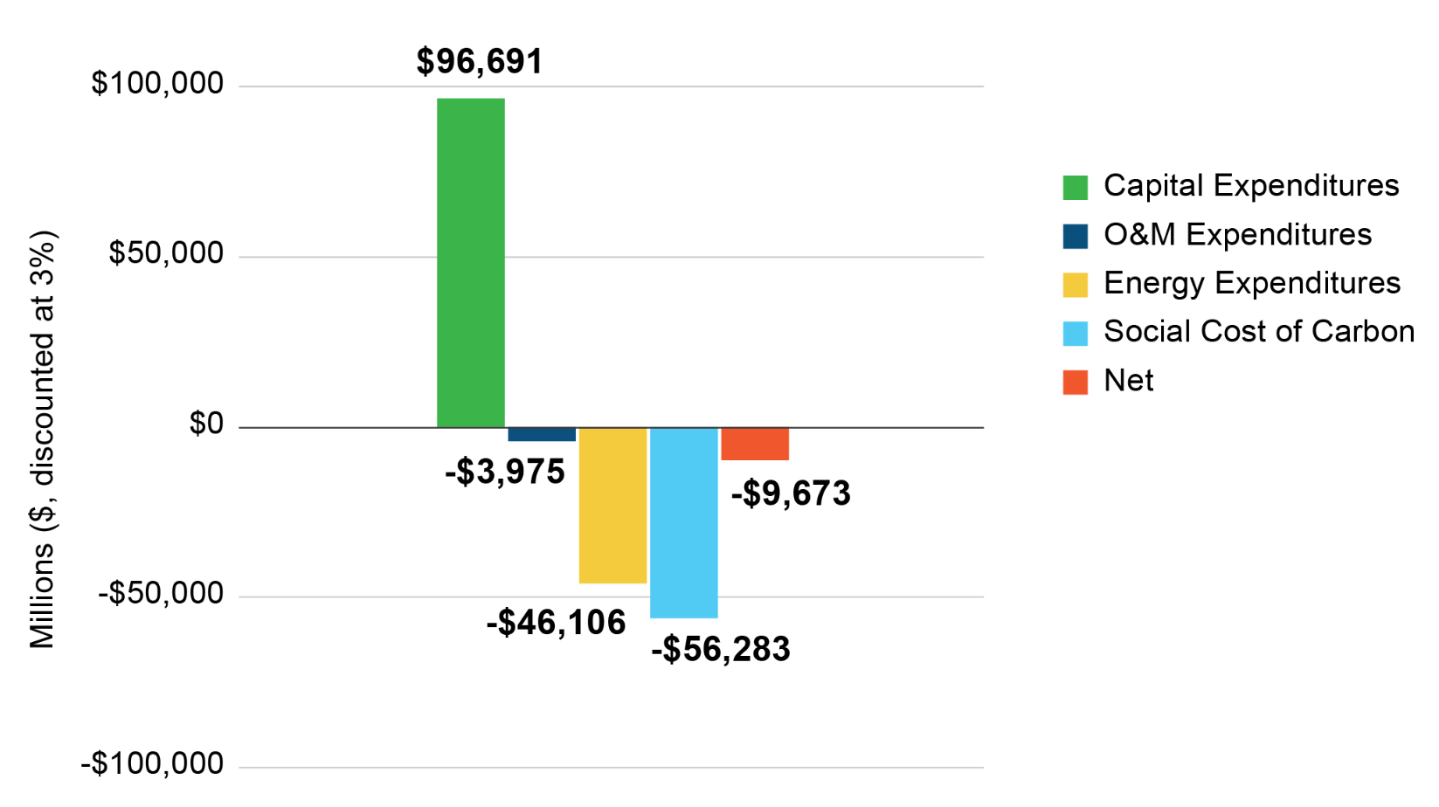
Cumulative Costs and Savings
Low Carbon Scenario Present Value (3% discounting rate, 2026-2050)
Notes:
I f you remove the social cost of carbon the npv is $24 billion

Slide 77
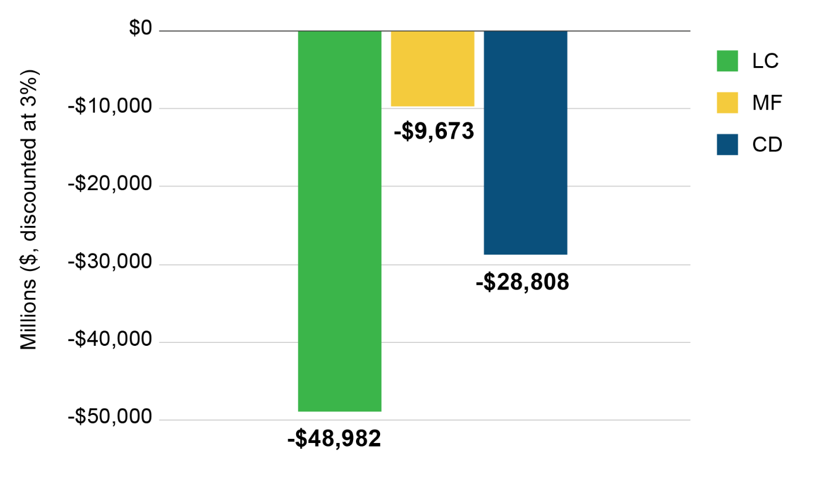
Cumulative Costs and Savings
Present Value in All Scenarios (3% discounting rate, 2026-2050)
Notes:
Yuill
All three scenarios result in net economic benefits.
Capital investments are nearly the same in each scenario at $100 billion over 25 years.
The LC scenario delivers nearly 2 times more economic benefits than the MF scenario.
The LC scenario is the most capital intensive early on, but generates the most financial savings over the long run.
All three scenarios generate cost savings through:
Reduced energy use
Lower operation and maintenance expenses
Decreased fuel costs

Slide 78
Sector Highlights
Photo taken and owned by NDCNR, permission granted to NDEP
Notes:
Kayla

Slide 79
Energy
Opportunity Area & Measures
Power Nevada with Clean Energy | Paths to a Clean, Renewable, Reliable, and Resilient Grid for Nevada
 | Expand Residential Solar Access and Affordability with Financing and Technical Support Programs
 | Adopt Initiatives Supporting Community Solar and Renewable Co-ops
 | Scale Up Solar Installation in Commercial Sector with Financing and Technical Support Programs
Notes:
Kayla
Key Assumptions:
Accelerated clean electricity grid in Low Carbon Scenario, slower to transition in Mixed Fuels and Community Driven
Residential and commercial solar installation increases in new buildings aligned with net zero building energy code adoption
Increased on-site solar installation in existing buildings in Low Carbon and Community Driven scenarios. Slower adoption in Mixed Fuels
Community solar is accelerated in Community Driven Scenario

Slide 80
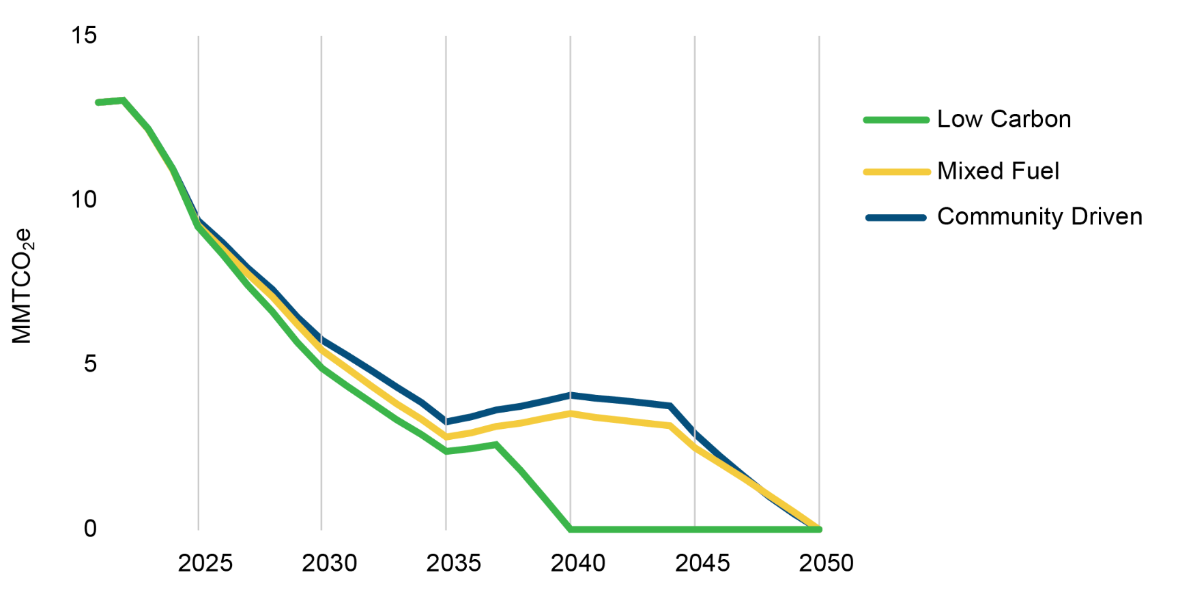
Comparison of Scenarios
GHG emissions from electricity consumption for all CCAN Scenarios, 2021-2050
LC Scenario achieves zero grid emissions in 2040
6
Notes:
Kayla
Local Energy Generation
Local generation ranges from 25% to 43% of Total Energy in 2050 in the three scenarios

Slide 81
Buildings
Opportunity Areas & Measures
Build Net Zero New Buildings | Strengthen Building Energy Conservation Codes
 | Adopt Net-Zero Ready Standards for All New Buildings
 | Invest in Zero-Emission Affordable Housing Options
Transform Existing Buildings | Establish Building Performance Standards for Existing Large Buildings
 | Retrofit Nevada - Modernize Homes Initiative
 | Retrofit Nevada - Modernize Businesses Initiative
 | Incentivize and Require Heat Pumps for Heating and Cooling in Residential Buildings
 | Incentivize and Require Heat Pumps for Heating and Cooling in Commercial Buildings
Notes:
Key assumptions: Net zero building energy code implemented
CD - 2027, LC - 2030, MF - 2036
Residential buildings and commercial retrofits across scenarios
CD focus on retrofitting low income areas first
Community Land Trusts and Zero-emissions rental housing options in CD
In all scenarios
Local governments adopt IECC at the same rate as the State
Building Performance Standards
Heat pump deployment in residential and commercial buildings, including replacing AC units with heat pumps

Slide 82
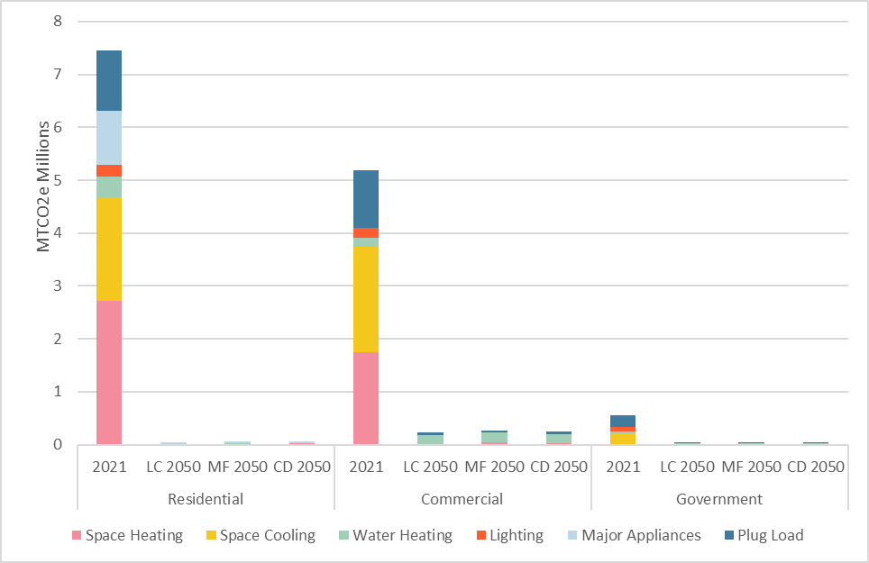
Comparing Scenarios
Total Building Emissions by Sector by End-Use
Aggressive measures to electrify buildings and clean up the grid reduce building emissions.
6

Slide 83
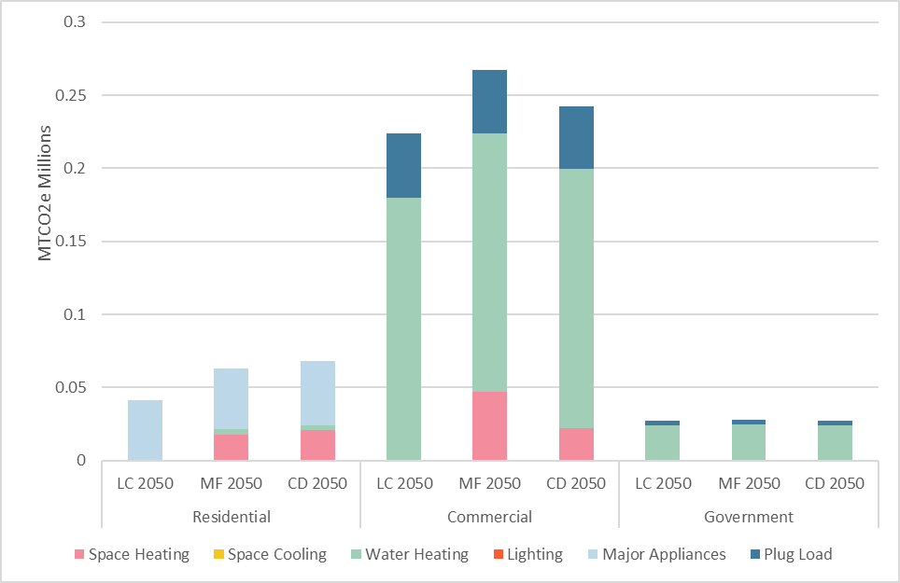
Comparing Scenarios
Total Building Emissions by Sector by End-Use
Heat pumps are the driving force in emission reduction in the building sectors.
6
Notes:
Heat pumps are the driving force in emission reduction in the building sectors

Slide 84
Transportation
Opportunity Areas & Measures
ZEV = Zero Emission Vehicle
Move with Active and Public Transit | Build Public Transit and Active Transportation Networks for Everyone
Accelerate Adoption of Zero Emission Vehicles for All | Launch ZEV for NV, an initiative to increase personal use ZEVs
 | Establish Lead the Charge, an Electrifying Public Fleets Assistance Program
 | Deploy Community-Based Electric Car Sharing Programs
Drive Sustainable Transport of Goods | Incentivize and Require the Clean Commercial Fleet Transition
 | Adopt Power Up Clean Worksites, an initiative to transition Off-Road Equipment to ZEVs
 | Fuel Sustainable Skies Program
 | Propel Marine Vessels to use Low- and Zero-Emission Fuels
Notes:
Key assumptions: Most ambitious active/transit mode share shifts in Community Driven Scenario
Accelerated electrification of personal use vehicles in Community Driven and Low Carbon Scenarios
More hydrogen vehicles and slower transition to ZEVs in Mixed Fuels Scenario
Community Driven Scenario also increase hydrogen use at a higher rate
Car sharing program in Community Driven Scenario
Increased use of SAF in Community Driven Scenario to reduce resident exposure to jet fuel.
In all scenarios:
Transitioning off road vehicles and marine vessels
Expanding charging infrastructure

Slide 85
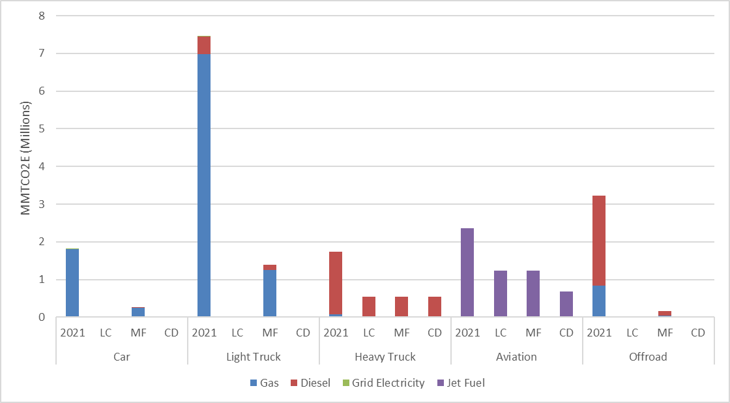
Hydrogen helps keep MF Heavy Truck emissions on par even with slower electrification
Comparing Scenarios
Total Transportation
Emissions by Vehicle Type
6

Slide 86
Industry
Opportunity Area & Measures
Decarbonize Industry | Maximize Industrial Energy Efficiency
 | Accelerate Deployment of Green Hydrogen for Industrial Decarbonization
 | Electrify Industrial Processes and Integrate On-Site Renewables
 | Support Industrial Carbon Capture, Utilization, and Storage (CCUS) Solutions
Notes:
Maximization of industrial energy efficiency accelerated in the Low Carbon Scenario
Accelerated energy efficiency and electrification in Low Carbon Scenario.
Increased hydrogen use in Mixed Fuels and Community Driven Scenarios
Community Driven Scenario accelerates electrification of industrial processes and on-site renewables
All scenarios adopt carbon capture, utilization, and storage solutions on the same timeline

Slide 87
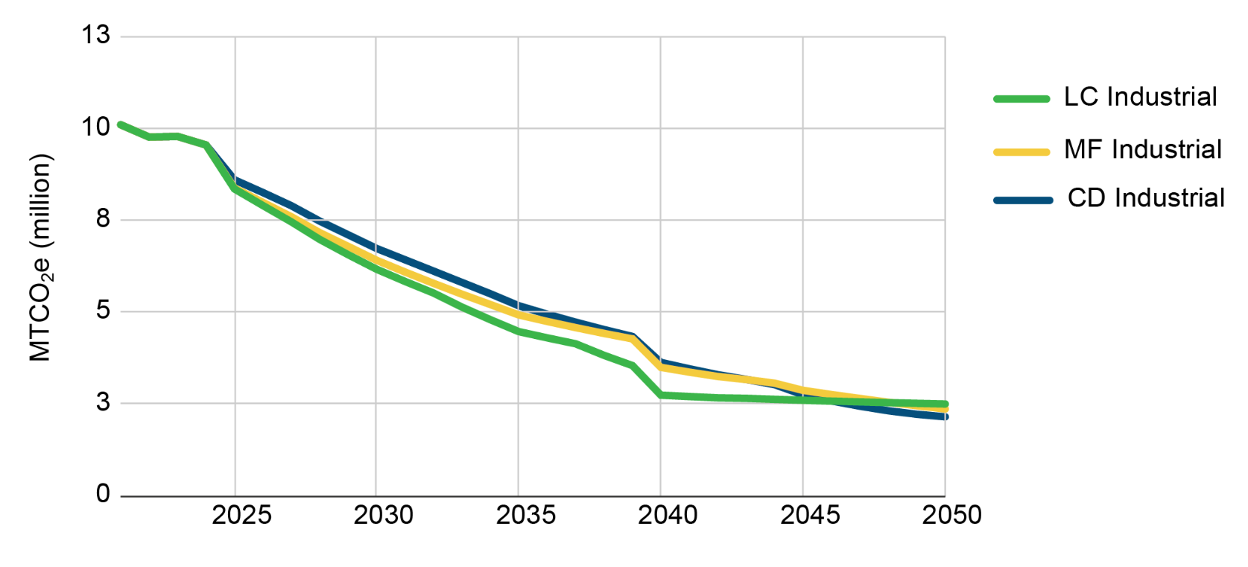
Comparing Scenarios
GHG emissions in the Industrial Sector by Scenario
6
Notes:
Hydrogen:
Significant increases will be required to achieve decarbonization in the industrial sector
Low Carbon Scenario - 20.58 MMBTU
Mixed Fuels Scenario - 26.44 MMBTU
Community Driven Scenario - 21.87 MMBTU
Nevada already has the largest hydrogen production plant in the world in North Las Vegas - Air Liquide/AirGas

Slide 88
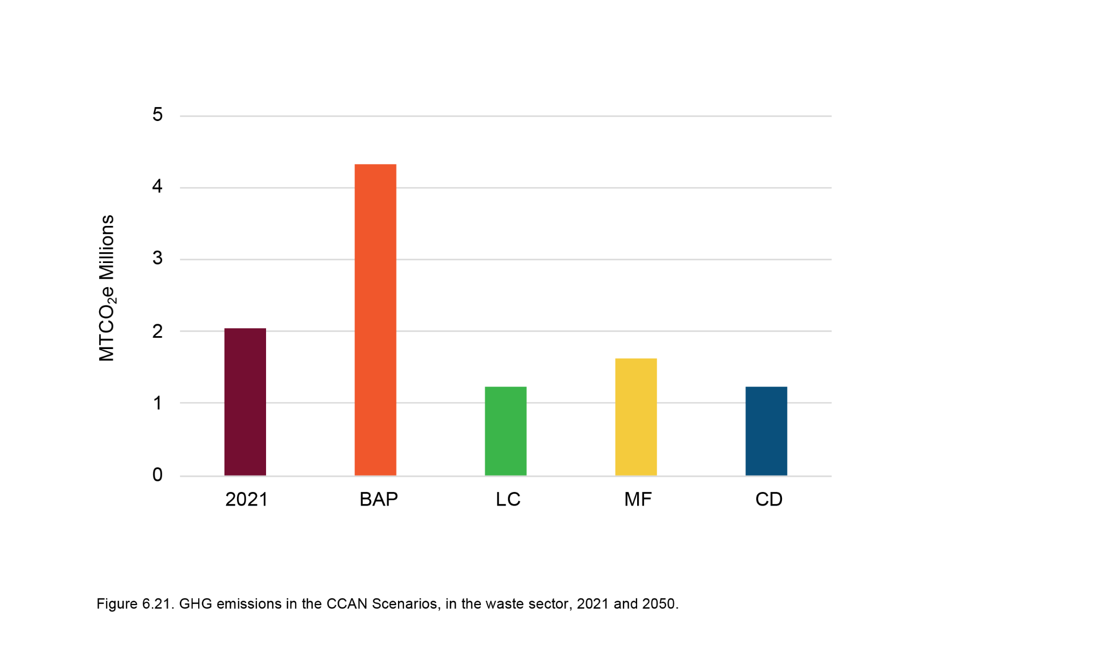
Waste
Waste Emissions by Scenario
Opportunity Areas & Measures
Divert and Reuse Waste | Expand recycling, composting, and sustainable materials management programs
Harness Landfill Gas | Develop and Fund Landfill Gas Capture and Utilization Systems
Notes:
Mixed Fuels Scenario has the most landfill gas capture
Community Driven Scenario makes landfill gas capture accessible to larger population centres
Higher rates of recycling and composting achieved in Low Carbon & Community Driven Scenarios

Slide 89
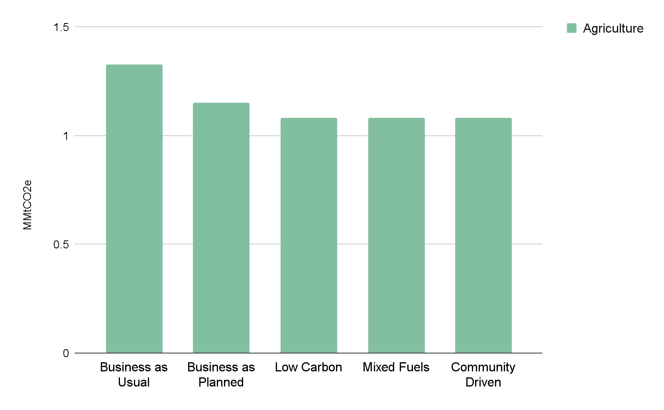
Agriculture
Agriculture Emissions by Scenario
Opportunity Area & Measures
Make Farming more Sustainable | Grow Regenerative Agriculture Practices in Nevada
 | Improve Grazing Management and Rangeland Resilience
While reductions are modest relative to other sectors, agriculture remains a key area for co-benefits such as improved soil health, water retention, and rural economic resilience.
Notes:
Agricultural lands are converted from conventional tillage to no-till and cover crop practices with the highest percentage being in the Low Carbon and Community Driven Scenarios
Grazing management is improved on rangelands with the highest percentage being in the Low Carbon and Community Driven Scenarios

Slide 90
Natural and
Working Lands
Over
7.5 MMTCO2e reduced annually by 2050
Opportunity Area & Measures
Grow Nature-Based Solutions | Expand Urban and Community Tree Canopy Coverage Across Nevada
 | Protect and Restore Natural Lands Initiative
More than a million
new trees
More
native plants and conservation
Notes:
Key Assumptions:
Cities to increase tree canopy cover to 30%
Prioritization of increased tree canopy cover in low income areas for the Community Driven Scenario
Protection and restoration of sagebrush and forested land in all three scenarios

Slide 91
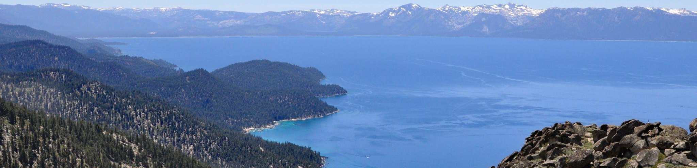
Closing
Notes:
Erica / Naomi

Slide 92
Appendix

Slide 93
BAU Scenario
BAP Scenario
Future Emissions Scenarios
More people
More buildings and homes
More heating and cooling needed
More cars
Mode shift to walking, biking, transit
More waste in landfills
Increased recycling and composting
More renewable energy
Zero emissions electricity
Some electric vehicles
More electric vehicles and infrastructure
Building Performance Standards
Net-Zero Building Code

Slide 94
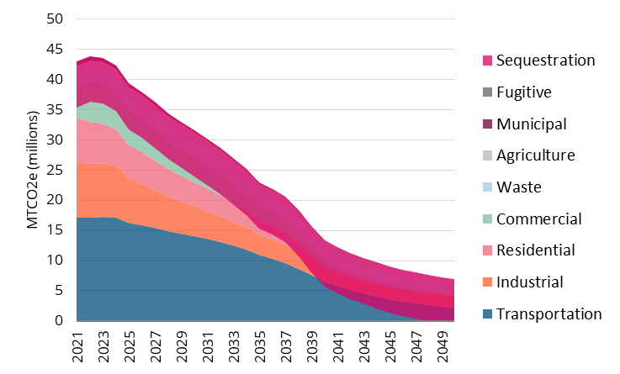
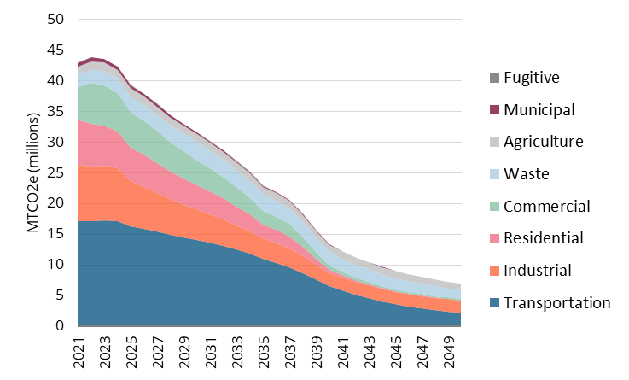
Low Carbon Scenario
Total Emissions by End-use Sector
6

Slide 95
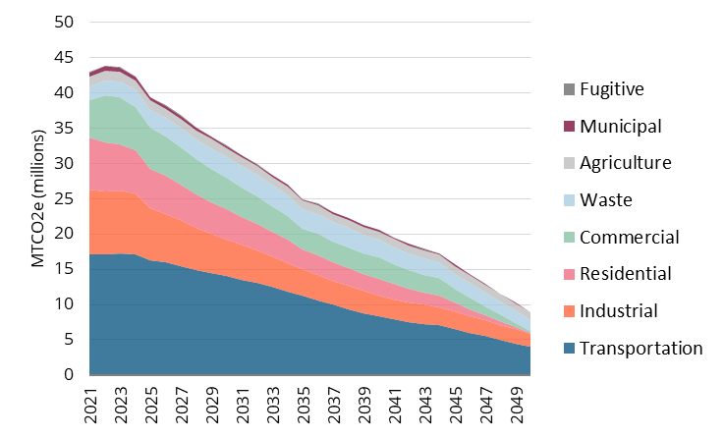
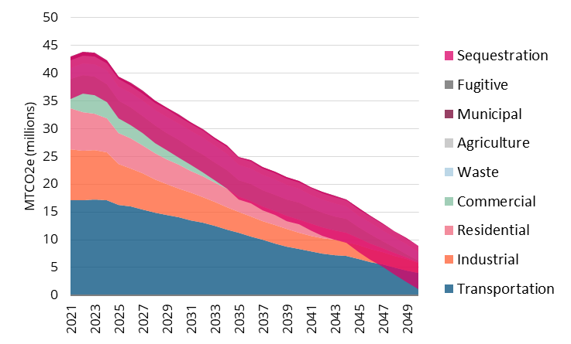
Mixed Fuels Scenario
Total Emissions by End-use Sector
6

Slide 96


Community Driven Scenario
Total Emissions by End-use Sector
6

Slide 97

Comparison of Scenarios
Total Emissions by Energy Source for each Scenario
6

Slide 98
Mixed Fuel Scenario
Wedge
Diagram
6
Notes:
Yuill

Slide 99
Community Driven Scenario
Wedge
Diagram
6
Notes:
Yuill

Slide 100

Low-Income and At-Risk Communities
6

Slide 101

Reductions in PM2.5
Reductions (%) in PM2.5 by zone by 2050 in relation to current areas with high energy burden in Nevada as defined in the LC Scenario.
6
Notes:
air quality benefits at a scale comparable to the most aggressive decarbonization pathway.”
“These findings are particularly important when thinking about public health, especially in areas that already experience elevated pollution levels. Reducing PM2.5 and other co-pollutants will bring significant, localized health benefits—especially for frontline communities.”

Slide 102
Reductions in PM2.5
Reductions (%) in PM2.5 by zone by 2050 in relation to current areas with high energy burden in Nevada in the LC Scenario
6

Slide 103
Employment Impacts
Cumulative Job Creation for Each Scenario (2026-2050)
Big Moves | Low-Carbon Scenario | Mixed Fuel Scenario | Community Driven Scenario
Transform Existing Buildings | 180,776 | 185,399 | 180,277
Build Net Zero New Buildings | 36,909 | 27,199 | 31,443
Retrofit Nevada - Modernize Businesses Initiative | 113,343 | 113,343 | 124,043
Power Nevada with Clean Energy | 24,557 | 24,126 | 55,383
Move with Active and Public Transit | -19,972 | -5,679 | 28,405
Accelerate Zero Emission Vehicles for All | -277 | 1,349 | -66,887
Drive Sustainable Transport | 192 | 130 | 192
Decarbonize Industry | 108,367 | 94,887 | 52,521
Divert and Reuse Waste | 5,896 | 5,896 | 5,896
Harness Landfill Gas | 24 | 24 | 24
Make Farming more Sustainable | 4,063 | 2,438 | 4,063
Grow Nature-Based Solutions | 315 | 339 | 312
6

Slide 104
Employment Impacts
Average annual person years of employment in each scenario (2026-2050),
relative to the BAP scenario
Big Moves | Low-Carbon Scenario | Mixed Fuel Scenario | Community Driven Scenario
Transform Existing Buildings | 7,532 | 7,725 | 7,512
Power Nevada with Clean Energy
Build Net Zero New Buildings | 1,538 | 1,133 | 1,310
Retrofit Nevada - Modernize Businesses Initiative | 4,723 | 4,723 | 5,168
Power Nevada with Clean Energy | 1,023 | 1,005 | 2,308
Move with Active and Public Transit | -832 | -237 | 1,184
Accelerate Zero Emission Vehicles for All | -12 | 56 | -2,787
Drive Sustainable Transport | 8 | 5 | 8
Decarbonize Industry | 4,515 | 3,954 | 2,188
Divert and Reuse Waste | 246 | 246 | 246
Harness Landfill Gas | 1 | 1 | 1
Make Farming more Sustainable | 169 | 102 | 169
Grow Nature-Based Solutions | 13 | 14 | 13
6

Slide 105
Employment Impacts
Cumulative Jobs by Sector (2026-2050)
Big Moves | Low-Carbon Scenario | Mixed Fuel Scenario | Community Driven Scenario
Construction | 313,529 | 313,729 | 319,846
HVAC equipment manufacturing | 16,785 | 11,743 | 14,461
Electric power generation, transmission and distribution | 25,272 | 24,596 | 56,839
Transit and ground passenger transportation | -20,000 | -5,707 | -38,302
Motor vehicle manufacturing | -57 | 1,506 | 12
Commercial and industrial machinery and equipment repair and maintenance | 108,367 | 94,887 | 52,521
Waste management and remediation services | 5,920 | 5,920 | 5,920
Crop production | 4,063 | 2,438 | 4,063
Support activities for agriculture and forestry | 315 | 339 | 312
6

Slide 106

Net Annual Costs or Savings
The LC scenario is the most capital intensive early on, but generates the most financial savings over the long run.
All three scenarios generate cost savings through:
Reduced energy use
Lower operation and maintenance expenses
Decreased fuel costs
Notes:
Yuill
“A key takeaway here is that low-carbon pathways tend to require significant capital investment early on, especially in areas like transportation electrification, clean energy infrastructure, and building retrofits.”
“But while the up-front costs are high, the long-term savings are substantial—and they grow over time as cleaner technologies reduce energy use, lower maintenance needs, and reduce fuel costs.”

Slide 107

Energy Affordability
A household faces a high energy burden when it spends more than 6% of its income on energy.
Cost-effective energy efficiency measures, such as improving insulation and installing more efficient appliances, have the potential to reduce energy use by 13-31%.
Transit-oriented urban development can reduce per capita use of automobiles by 50%, reducing household transport expenditures by 20%.
Notes:
Kayla
Let’s now look at one of the most critical co-benefits for households across Nevada — energy affordability.
A household is considered to have a high energy burden when it spends more than 6% of its income on energy. This burden is especially severe for low-income families, who often live in less efficient homes and have limited access to alternatives.
The good news is that many climate actions — like improving building performance and expanding transportation options — can also reduce energy bills and improve affordability.
For example:
Energy efficiency upgrades — like insulation, sealing air leaks, and installing more efficient appliances — have the potential to reduce household energy use by 13% to 31%.
Transit-oriented urban development — designing communities so people can walk, bike, or use public transit — can cut per capita automobile use by up to 50%, leading to transportation cost savings of around 20% per household.”
These savings aren’t just good for the climate — they reduce financial stress for families, especially in communities already facing high housing and utility costs.
So, when we talk about building a clean energy future, we’re also talking about a more affordable and equitable future for Nevadans.

Slide 108

CAPEX + OPEX
Capital Investments
Community based, result in jobs, new economic activities
Operating Expenses
Decrease up to 50% due to increased efficiency across all sectors
Revenue
Renewable energy, transit fees, etc
Return on Investment

Slide 109

Example Assumptions
Purchasing 1 EV vehicle costs $7,000 more than an Internal Combustion Engine equivalent vehicle in 2021.
Fuel savings from switching from gasoline to electricity are $2,000 per year.
Maintenance cost savings for switching to an EV are $500 a year.
Useful life for an EV is 10 years.

Slide 110


Cash Flow - Undiscounted
Electric Vehicles
t = 10 years
Investment premium of buying EV versus gas/diesel equivalent
6
Notes:
The first year includes a large capital investment to purchase EVs—this is the up-front cost premium compared to conventional vehicles.In the following years, we start to see cost savings emerge from two main sources: lower fuel costs and reduced maintenance costs.

Slide 111

Cash Flow - Discounted
Net Present Value
Sum of all the years of discounted cash flows:
NPV = $14,326
A 5 year useful life instead of 10 would result in an NPV of $4,449.
6
Notes:
Considering the discounted rate. This chart reflects discounted cash flows using a 3% social discount rate—meaning future costs and savings are weighted less heavily than present ones as such there are less savings overtime.

Slide 112

Cash Flow - Discounted
Net Present Value
Which has a higher discounting rate?
a
b
6

Slide 113


Cash Flow - Discounted
2021 investment in EV1 - savings for EV1
Investment costs vary by year
Fuel costs vary by year
Investment for EV2 - savings from EV2 - savings from EV1
Fuel and maintenance savings for both EVs
Fuel and maintenance savings for EV2 only
6
Notes:
Let’s say the state purchases its first EV in 2021. That’s the initial investment—represented on the top left. After that investment, the EV starts generating savings each year through lower fuel and maintenance costs.
The following year the state purchases a second EV. Now we’re tracking both the costs and the additional savings generated by having two EVs in operation.
“The bars you see represent that mix of cash flows across time—first the investment, then the benefits. And the important piece here is that we’re applying a 3% discount rate to those cash flows.”

Slide 114

Cash Flow - Discounted
End of analysis year = 2030
Net Present Value
Discounting these cash flows at 3% results in a -$200M NPV over vehicle lifetime
6

Slide 115

Net Annual Cost or Savings
Annual Investment and Savings in the MF Scenario (2026-2050)
Pivot point
2044
6

Slide 116

Cumulative Costs and Savings
Mixed Fuel Present Value (3% discounting rate, 2026-2050)

Slide 117

Net Annual Cost or Savings
Annual Investment and Savings in the CD Scenario (2026-2050)
Pivot point
2041
6

Slide 118

Cumulative Costs and Savings
Community Drive Present Value (3% discounting rate, 2026-2050)

Slide 119
Social Cost of Carbon
Socio-Economic Model
Calculates future population, GDP and GHG emissions
Calculates temperature change, sea level rise and other hazards as result of the GHG emissions
GHG Emissions
Global Climate Model
Climate Change Impacts
Damages Model
Calculates the costs of the damage resulting from the climate hazards to infrastructure and economies
Monetized Damages
Discounts* the future damages caused by GHG emissions from one year back to that year.
Discounting
An estimate of the economic value of the damage caused by 1 MtCO2e from one year
Social Cost of Carbon
*a discount rate of 3% was used for this analysis
Notes:
“By applying the SCC, we can compare the societal benefits of avoided emissions against the economic costs of climate actions—essentially conducting a benefit-cost analysis that includes long-term, intergenerational impacts.”
“This is especially relevant for measures where the financial return may not appear strong initially, but where the avoided societal harm—over decades—is significant.”
“In our analysis, we used three modeling frameworks to estimate SCC:
A Socio-Economic Model to forecast emissions and economic growth,
A Global Climate Model to simulate temperature and sea level rise,
And a Damages Model to monetize the effects of those changes on people and the economy.”
“We used a 3% discount rate, consistent with federal guidance, to reflect the value of future damages today.”

Slide 120
Natural and
Working Lands
Key Assumptions
Cities to increase tree canopy cover to 30%
Prioritization of increased tree canopy cover in low income areas for the Community Driven Scenario
Protection and restoration of sagebrush and forested land in all three scenarios

Slide 121


Net Annual Cost or Savings
Annual Investment and Savings in the LC Scenario with SCC (2026-2050)
Pivot point
2036
Costs money
Saves money
6

Slide 122

Net Annual Cost or Savings
Annual Investment and Savings in the MF Scenario with SCC (2026-2050)
Pivot point
2037
6

Slide 123
Net Annual Cost or Savings
Annual Investment and Savings in the CD Scenario with SCC (2026-2050)
Pivot point
2036
6

Slide 124


Cumulative Costs and Savings
Low Carbon Present Value with SCC (3% discounting rate, 2026-2050)
Highest
savings

Slide 125

Cumulative Costs and Savings
Mixed Fuel Present Value with SCC (3% discounting rate, 2026-2050)

Slide 126

Cumulative Costs and Savings
Community Drive Present Value with SCC (3% discounting rate, 2026-2050)

Slide 127


Cumulative Costs and Savings
Low Carbon Present Value with SCC (3% discounting rate, 2026-2050)

Slide 128

Concepts & Definitions
Financial Analysis
Abatement Cost
The abatement cost of an action is the estimated cost for that action to reduce one metric ton of GHG emissions, calculated by dividing the action’s NPV by the total GHG emissions reductions (tCO2e) resulting from the action.

Slide 129

Abatement Cost
$/tCO2e reduced for each LC Measure
6

Slide 130

Abatement Cost
$/tCO2e reduced for each MF Measure
6

Slide 131

Abatement Cost
$/tCO2e reduced for each CD Measure
6

Slide 132
Energy
Key Assumptions
Accelerated clean electricity grid in Low Carbon Scenario, slower to transition in Mixed Fuels and Community Driven
Residential and commercial solar installation increases in new buildings aligned with net zero building energy code adoption
Increased on-site solar installation in existing buildings in Low Carbon and Community Driven scenarios. Slower adoption in Mixed Fuels
Community solar is accelerated in Community Driven Scenario

Slide 133


Comparison of Scenarios
Community Driven Scenario
The Community Driven Scenario
Local generation is 43% of Total Energy in 2050
6

Slide 134


Comparison of Scenarios
Local vs Grid Electricity
LC Scenario
Local generation is 36% of Total Energy in 2050
MF Scenario
Local generation is 25% of Total Energy in 2050
CD Scenario
Local generation is 43% of Total Energy in 2050
6

Slide 135
Buildings
Key Assumptions
Net zero building energy code implemented
CD - 2027, LC - 2030, MF - 2036
Residential buildings and commercial retrofits across scenarios
CD focus on retrofitting low income areas first
Community Land Trusts and Zero-emissions rental housing options in CD
In all scenarios
Local governments adopt IECC at the same rate as the State
Building Performance Standards
Heat pump deployment in residential and commercial buildings, including replacing AC units with heat pumps

Slide 136

Low Carbon Scenario
Total Building Emissions by Fuel Type
Across scenarios
natural gas makes up the remaining fuel types.
Primarily used for water heating in commercial and government buildings and major appliances (i.e. dryers) in Residential Buildings.
6

Slide 137
Transportation
Key Assumptions
Most ambitious active/transit mode share shifts in Community Driven Scenario
Accelerated electrification of personal use vehicles in Community Driven and Low Carbon Scenarios
More hydrogen vehicles and slower transition to ZEVs in Mixed Fuels Scenario
Community Driven Scenario also increase hydrogen use at a higher rate
Car sharing program in Community Driven Scenario
Increased use of SAF in Community Driven Scenario to reduce resident exposure to jet fuel.
In all scenarios:
Transitioning off road vehicles and marine vessels
Expanding charging infrastructure

Slide 138

Comparison of Scenarios
Total Emissions by Sector in 2050
Transportation is one of the state’s largest emitters and remains a key sector to decarbonize.
6

Slide 139

Comparison of Scenarios
Total Emissions by Energy Source
6

Slide 140
Industry
Key Assumptions
Maximization of industrial energy efficiency accelerated in the Low Carbon Scenario
Accelerated energy efficiency and electrification in Low Carbon Scenario.
Increased hydrogen use in Mixed Fuels and Community Driven Scenarios
Community Driven Scenario accelerates electrification of industrial processes and on-site renewables
All scenarios adopt carbon capture, utilization, and storage solutions on the same timeline

Slide 141

Hydrogen
Significant increases will be required to achieve decarbonization in the industrial sector
Low Carbon Scenario - 20.58 MMBTU
Mixed Fuels Scenario - 26.44 MMBTU
Community Driven Scenario - 21.87 MMBTU
Nevada already has the largest hydrogen production plant in the world in North Las Vegas - Air Liquide/AirGas

Slide 142

Comparing Scenarios
Industrial building emissions by End Use
6

Slide 143

Waste
Key Assumptions
Mixed Fuels Scenario has the most landfill gas capture
Community Driven Scenario makes landfill gas capture accessible to larger population centres
Higher rates of recycling and composting achieved in Low Carbon & Community Driven Scenarios

Slide 144
Comparing Scenarios
Waste Emissions
6

Slide 145

Agriculture
Key Assumptions
Agricultural lands are converted from conventional tillage to no-till and cover crop practices with the highest percentage being in the Low Carbon and Community Driven Scenarios
Grazing management is improved on rangelands with the highest percentage being in the Low Carbon and Community Driven Scenarios

